Slide 1
Open-Source Dynamic Traffic Assignment Package
DTALite/NEXTA Classic Edition
(2017 September)
Xuesong Zhou
xzhou99@gmail.com
xzhou74@asu.edu

Slide 2
Workshop Purpose and Objectives
Purpose
Educate workshop attendees on Dynamic Traffic Assignment modeling through hands-on exercises using the open-source DTALite software tool
Learning Objectives
Understand basic modeling approaches in DTALite
Import data to code and modify a subarea network
Evaluate simulation results using the visualization and reporting features in NeXTA
2
Notes:
The purpose of the workshops is to educate attendees on Dynamic Traffic Assignment modeling using hands-on exercises with the open-source DTALite software tool. In general, the workshop will focus on understanding basic modeling approaches in DTALite, importing data in NeXTA, analyzing toll facilities and work zones, and evaluating simulation results using visualization and reporting features in NeXTA.

Slide 3
Outline
Module 1: Introduction to DTALite/NeXTA
Module 2: Introduction to DTA modelling principles
Module 3: Visualization Features in NeXTA
Module 4: Introduction to Workshop Exercises
Module 5: Traffic Flow Theory
Module 6: OD Matrix Estimation
Module 7: Signalized Intersections Modeling
Module 8: VRP program
3
Notes:
As I just mentioned, the webinar is divided into four parts, referring to four separate videos which make up this recorded session. This is the first session, where we’ll introduce you to DTALite and NeXTA, and provide an overview of our project development so far.

Slide 4
Module 1 Introduction to DTALite/NeXTA
1.1 Project Objective and Motivations
1.2 What NeXTA/DTALite Can Do
1.3 Open-source Free Software Package

Slide 5
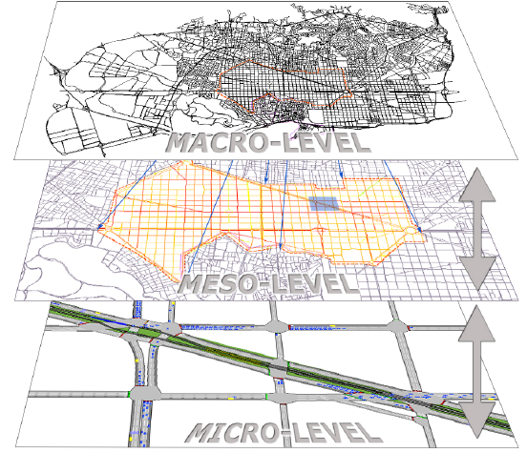
Mesoscopic Traffic Simulation

Slide 6
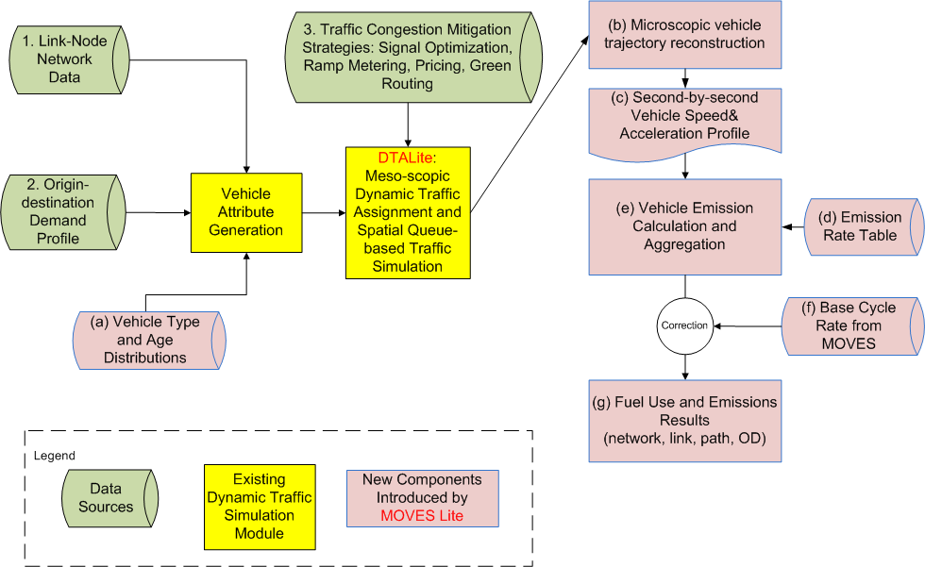
System Architecture and Data Flow

Slide 7
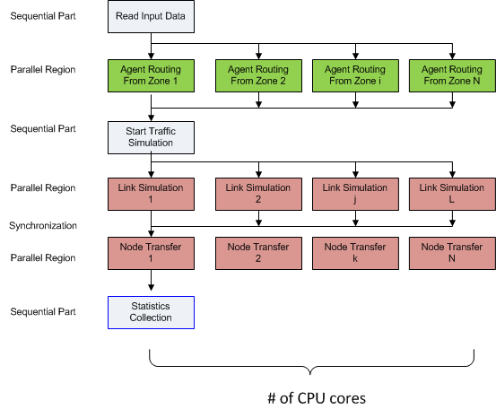
Computational Efficiency

Slide 8
1.0 Traffic Flow Theoretical Foundation: LWR Equations
Hyperbolic system of conservation laws
where q, k are flow and density, respectively, and g(·) is the net vehicle generation rate.
Traffic flow model
Speed (or flow) of traffic is a function of density only
E.g. Greenshields model: V = V_{free} (1 – k/K_{jam})

Slide 9
Numerical Calculation Scheme Based on Link Flow/Density (Used in CTM)
Notation
Δt = length of simulation interval (e.g. 1 sec, 6 sec)
Δx = cell length (e.g. 0.5 mile)
k_{i,t} , v_{i,t} =the prevailing density and mean speed in cell i during the t^{th} time step
q_{i,t} = transfer flow rate from section i to cell i+1 during the t^{th} time interval [t, t+Δt].
Computation Procedure
Step 1: Calculate prevailing speed v_{i,t} according to a traffic flow model
Step 2: Calculate flow ready to move from cell i-1 to section i: v_{i,t}×k_{i,t}
Step 3: Calculate transfer flow from section i to cell i+1
q_{i,t} = Min { v_{i,t} × k_{i,t} , q_{max i+1,t} }
Step 4: Update prevailing density at cell i
k_{i,t+1} = k_{i,t} + (q_{i-1,t} – q_{i,t}) × Δt /Δ x
Issue: transfer flow q_{i,t} is an explicit function of the occupancy at the current cell, other than the downstream capacity
Transferred flow exceeds the spatial storage capacity at the next cell

Slide 10
Newell’s N-Curve Approach (Used in DTALite)
N_{i} (t): cumulative flow counts at location i at time t
q=[N_{i}(t+1)-N_{i}(t)]/Δt
K=[N_{i+1}(t)-N_{i}(t)]/ΔX
Focus on N-curve at transfer points
N=Min {N_{upstream}, N_{downstream}}
Focus on change of N along a characteristic line (wave) at sections
dN = (∂N/∂x)dx + (∂D/∂t)dt = - kdx + qdt =
(-k+ q × wave)dx
if wave=v_{free}, dN=( -k + k) dx=0
if wave=w, dN=-(k+qw)dx= -k_{jam}dx

Slide 11
Illustration of N-Curve Computation For Tracking Queue Spillback

Slide 12
Summary of Comparison
CTM’s variables are density, incoming and outgoing flows and speed
Newell’s variables are incoming and outgoing cumulative flow counts, from which the density and flows can be derived.
We do not have direct speed measurements and link travel times are calculated from vehicle trajectories (with arrival times at upstream node and departure time at downstream node)

Slide 13
Simulation Logic as Simple Queue
Can be viewed as pseudo event-based simulation and we do not simulate how a vehicle moves inside the link
Vehicle is moved into an in-flow queue at time t_{a}
Calculate time entering the out-flow queue as t_{a}+FFTT (free-flow travel time)
If the current simulation time t equals to or is later than t_{a}+FFTT, if the link out capacity is still available, move this vehicle to the next link, otherwise stay in the out-flow queue
Out –flow
Queue
Available capacity
at every simulation interval
In-flow Queue
Notes:
How to Determine Link-In Capacity at Each Simulation Interval
Free-flow or partially congested → use pre-specified reduced capacity
Fully congested according to N-Curve formula
--> Link-out flow rate from the previous simulation interval
How to Determine Link-Out Capacity at Each Simulation Interval
Minimal of the following elements
Pre-specified Average Capacity
If a link is fully congested, its link-in capacity will be distributed to incoming links as function of lanes

Slide 14
Network Traffic Flow Model
Goal: define boundary conditions for each link
Downstream link capacity distribution at merges
Outflow distribution at diverges
Congestion from downstream link:
q(i1→i)+q(i2→ i)<= w × (k_{jam} - k_{i,j}(t)) × Δ x
or d1+d2<s
Outflow distribution: q(i→i3)+q(i→ i4)=q(i)
OD flow pattern, turning percentages

Slide 15
In-Flow Capacity Distribution Schemes at Merges with two ramps or two freeways
Flows are assumed to be proportional to # of lanes
whenever supplies are not adequate,

Slide 16
Traffic Flow Model at Diverge
As a meso-scopic model, DTALite moves vehicles with OD and path specific information instead of continuous flow
Outflow distribution is dependent on
OD flow pattern, turning percentages

Slide 17
Time-Dependent Shortest Path Algorithm
C++ implementation
Use standard template library (STL) for complicating data structure (e.g. multi-dimensional vector, list, map (hash table)
Customized efficient structure for shortest path algorithm
Multiple processor-oriented
OpenMP technique for using multiple processors
Shortest path algorithm
Label correcting with deque
Single departure time, origin-based.
The algorithm is called iteratively for each departure time to calculate shortest paths for all departure times

Slide 18
What NeXTA/DTALite Can Do
Open-source traffic simulation/modeling Data Hub
Integrated simulated and measured data management tools
Connection with Travel demand model, signal optimization tool (Synchro)
Large-scale dynamic traffic assignment
Typical network size: 2K~5K zones, 20K~50K links, 2~4 Million vehicles
Network scenario analysis
Rich outputs: various operational performance measures
Road pricing application: Consider time-dependent toll, Heterogeneous Value of times

Slide 19
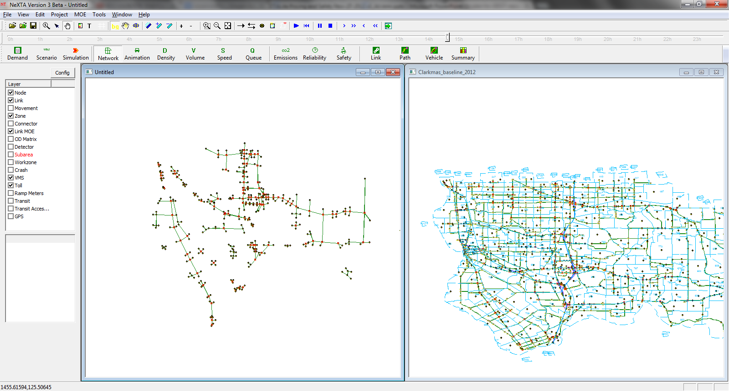
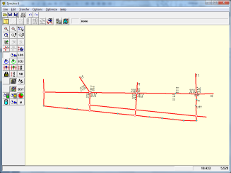
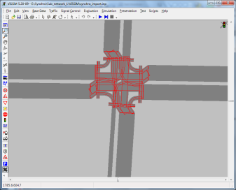
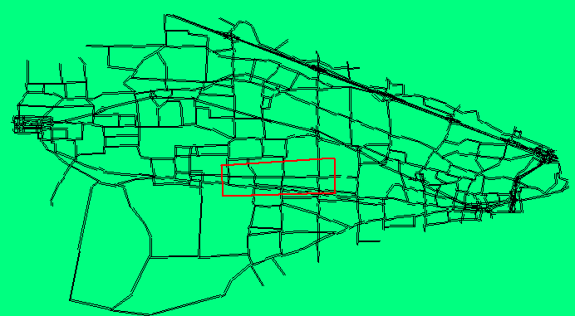
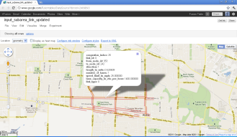

Slide 20
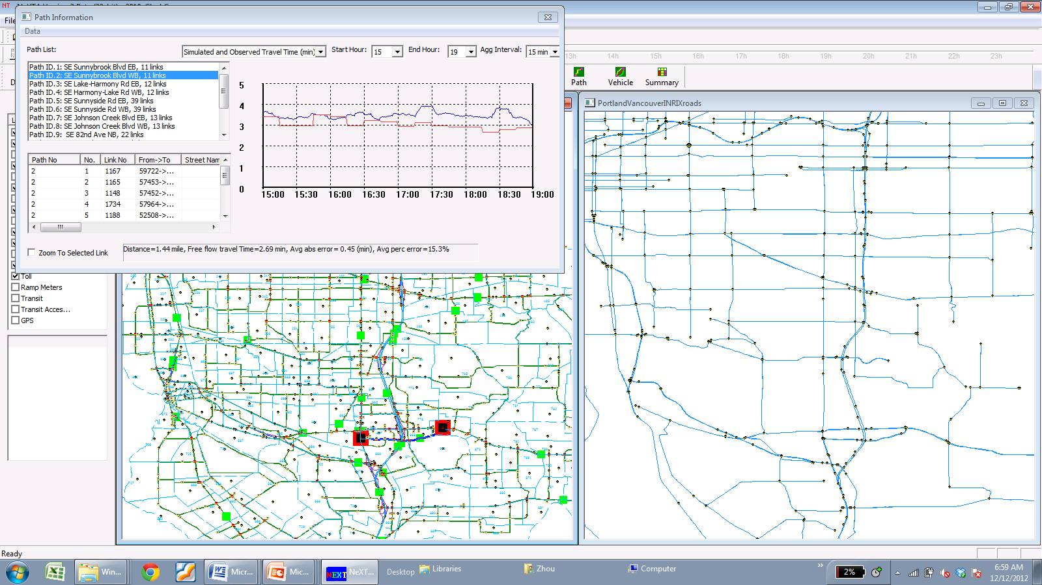
Connection with Traffic Sensor Data
Import TMC GIS data directly to NEXTA
Match TMC links with planning links using two layers
Fetch speed data from Inrix layer to AMS data bub
Compare the observed vs simulated results
Simulated vs Observed Path Travel Time
Inrix Speed Data with TMC Codes
MPO Planning Data

Slide 21
1.1 Project Objective and Motivations
Project Objective
Enhance DTALite to provide a rigorous and computationally efficient tool to evaluate road pricing and crash-reduction strategies
The enhanced tool will enable practitioners to:
Assess corridor and network-wide effects
Conduct numerous alternatives analyses
Evaluate recurring and non-recurring congestion
Calculate performance measures that can be applied in investment-level planning and decision making
21
Notes:
The project objective was to enhance DTALite by providing a rigorous and computationally-efficient tool for evaluating road pricing and crash reduction strategies. The end goal was to enable practitioners to assess corridor and network-wide effects, leverage DTALite’s computational efficiency to conduct numerous alternatives analyses, evaluate recurring and non-recurring congestion, and calculate performance measures which can be applied in investment-level planning and decision making.

Slide 22
Motivations
1.1 Project Objective and Motivations
Existing technical barriers (based on DTA user survey, TRB network modeling committee, 2009)
- Require too many input data: 47%
- Take too long to run: 35%
- Model is unclear: 35%
Our goals
- Simplified data input from static traffic assignment
- Use parallel computing capability, simplified routing and
simulation
- Open-source Visualization: Seeing is believing
- Excel Tools: Start from basics
22

Slide 23
1.2 What NeXTA/DTALite Can Do
Open-source traffic simulation/modeling Data Hub
(1) Connection with signal optimization (Synchro) or microscopic simulation (VISSIM)
(2) Integrated simulated and measured data management tools
Large-scale dynamic traffic assignment
(1) Typical network size: 2000 zones, 20K links,1-2 Million vehicles
Network scenario analysis
(1) Road pricing application: Consider time-dependent toll, Heterogeneous Value of times
(2) Emission study: Fast simulation for emission analysis (with MOVES Lite)
(3) Safety planning: Predict annual crash rates based on link type and traffic volume
23

Slide 24
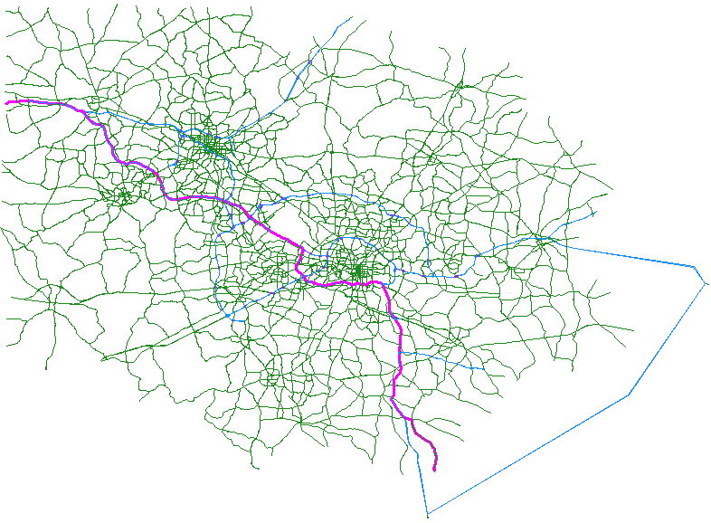
1) Fast Simulation
1.2 What NeXTA/DTALite Can Do
A rigorous and computationally efficient tool to evaluate numerous alternatives analyses
Network Statistics
Triangle Corridor Network (NC, USA)
Zones = 2,389
Nodes = 9,528
Links = 20,258
Signals = 1,914
AM Trips = 1,064,703
Households = 490,000
2 min. 45 sec. / iteration
1hour for 20 iterations
Computer System Specification:
CPU: Intel i7-2960XM @ 2.70 GHz *8
Memory: 16.0 GB
System Type: 64-bit Windows 7
24

Slide 25
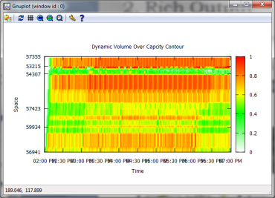
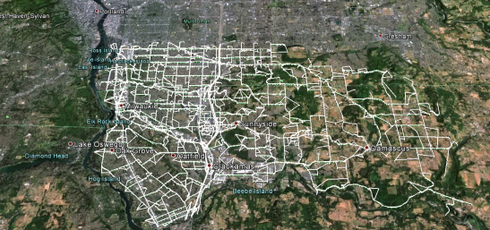
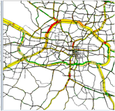
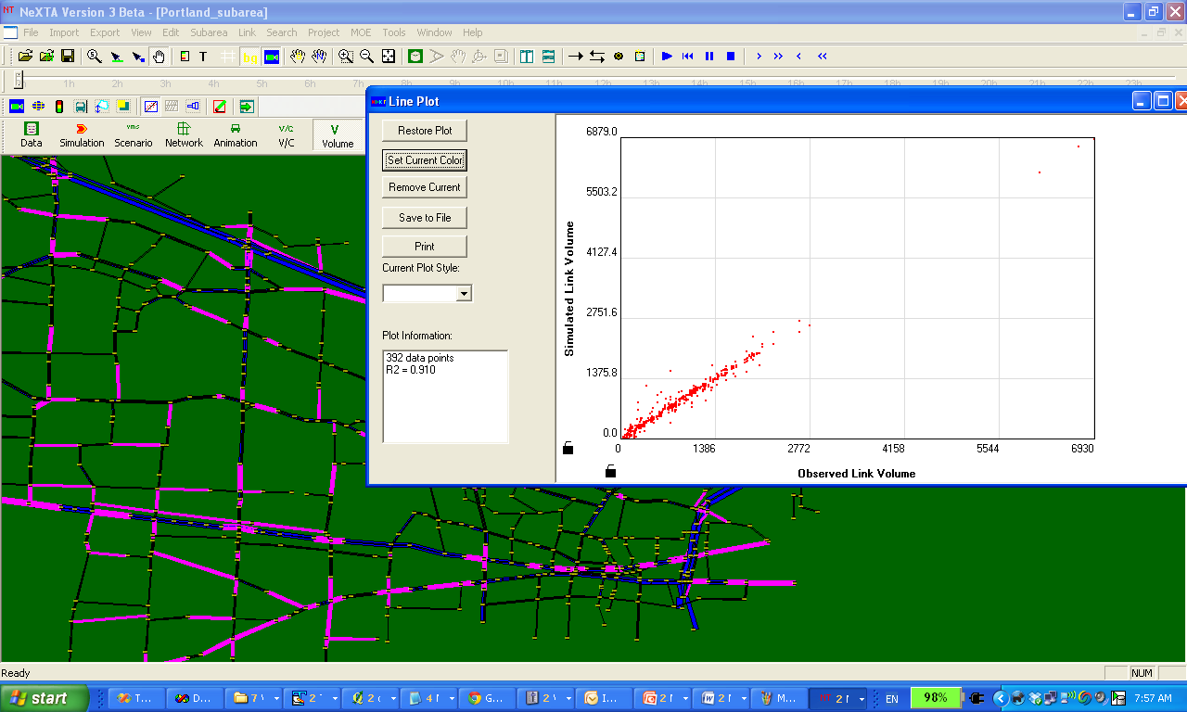
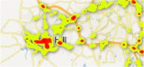
1.2 What NeXTA/DTALite Can Do
2) Rich Output
Other Visualization
Corridor-level VOC contour
Simulation vs. Observation Comparison
Google Earth/Maps
NeXTA
Large-scale Dynamic Traffic Assignment & Simulator
25

Slide 26
1.2 What NeXTA/DTALite Can Do
3) Integrated Modeling Practice
Current Practice Ad Hoc
With NeXTA Data Hub Systematic
Field Data
Land Use, Safety & Emissions Models
HCM & Signal Timing Models
Micro-simulation Models
Dynamic Traffic Assignment Models
Travel Demand Forecasting Models
Data Hub
Field Data
Land Use, Safety & Emissions Models
HCM & Signal Timing Models
Micro-simulation Models
Dynamic Traffic Assignment Models
Travel Demand Forecasting Models
NeXTA Data Hub
26

Slide 27
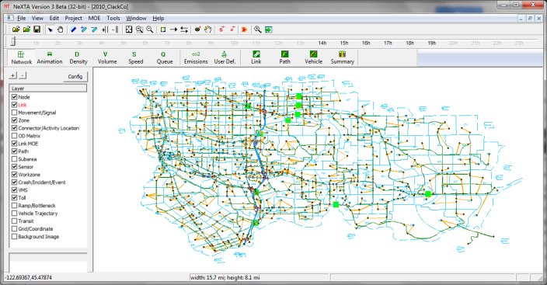
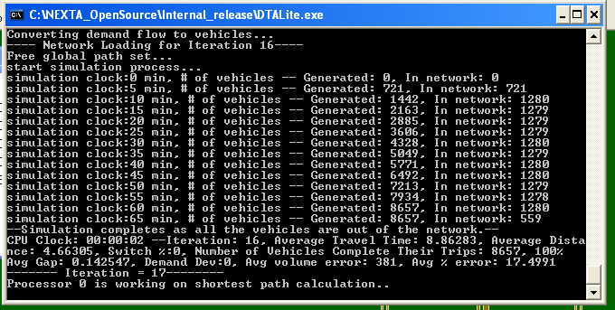
1.3 Open-source Free Software Package
NEXTA: front-end GUI (C++)
Version 2: GUI for TRANSIMS and DYNASMART
Version 3: GNU Open-source data hub
Import
Other regional planning models (TransCAD, VISSUM, Cube)
GIS shape files (household data without node layer)
Traffic volume, speed, GPS data, Google Public Transit Feed
Export
Google Earth, Google fusion tables
Prepare network and signal data for
Synchro and VISSIM (through QEM)
DTALite: Open-source computational engine (C++)
Light-weight and agent-based DTA
Built-in OD demand matrix estimation (ODME) program
27

Slide 28
Useful Materials
DTALite Software Release
https://github.com/xzhou99/dtalite_software_release
NeXTA/DTALite Training Materials
https://github.com/xzhou99/learning-transportation/tree/master/lessons
DTALite Source Codes
https://github.com/xzhou99/dtalite_beta_test
28

Slide 29
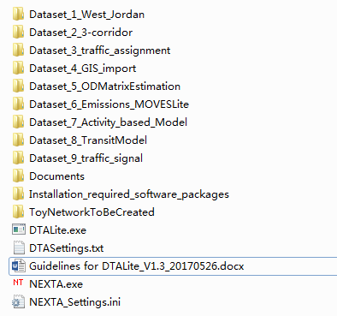
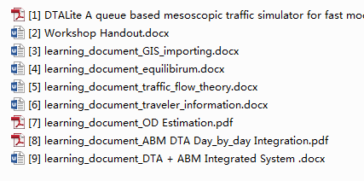
Useful Materials
Installation required software packages
Datasets and Learning documents
User Guide
29

Slide 30
Module 2 Introduction to DTA modelling principles
2.1 Dynamic Traffic Assignment Modelling Framework
2.2 Agent-based Routing
2.3 VOT Distribution
2.4 Multiple Traffic Simulation Models

Slide 31
2.1 DTA Modelling Framework
31
Notes:
In general, the traffic simulation assigns vehicles to different paths based upon link travel time. The physical process of moving vehicles works in a two-step process. First, a vehicle is moved across a link during the link pass, and then moved between links at the node during the node pass. Link travel times from the traffic simulator are fed to the shortest path model for path selection. The new paths are then fed back into the traffic simulator in the next iteration.

Slide 32
2.2 Agent-based Routing
Common Assignment Methods
(1) Traffic Analysis Zone (TAZ)-based
From zone centroid to zone centroid
The same value of time for each type of vehicles
(2) Agent-based
From activity location to activity location
Each vehicle has its own value of time, value of information
Important for road tolling analysis, traveler information provision study
32

Slide 33
2.2 Agent-based Routing
Routing performed for each individual agent
Each agent has multiple dimensions of travel decisions
Origin, destination, departure time, path
Demand class (LOV, HOV, truck) or (HBW, HBO, NHB)
Information class (Historical, Pre-trip, En-route)
33

Slide 34
2.2 Agent-based Routing
Individual generalized cost function
Can consider multiple factors
Value of time, Value of reliability, Value of safety
Perform routing algorithm individually for each vehicle/agent
Can adjust origin/destination/departure time/path at each iteration (day)
$$Cost=Travel Time∗VOT+Toll$$
34

Slide 35
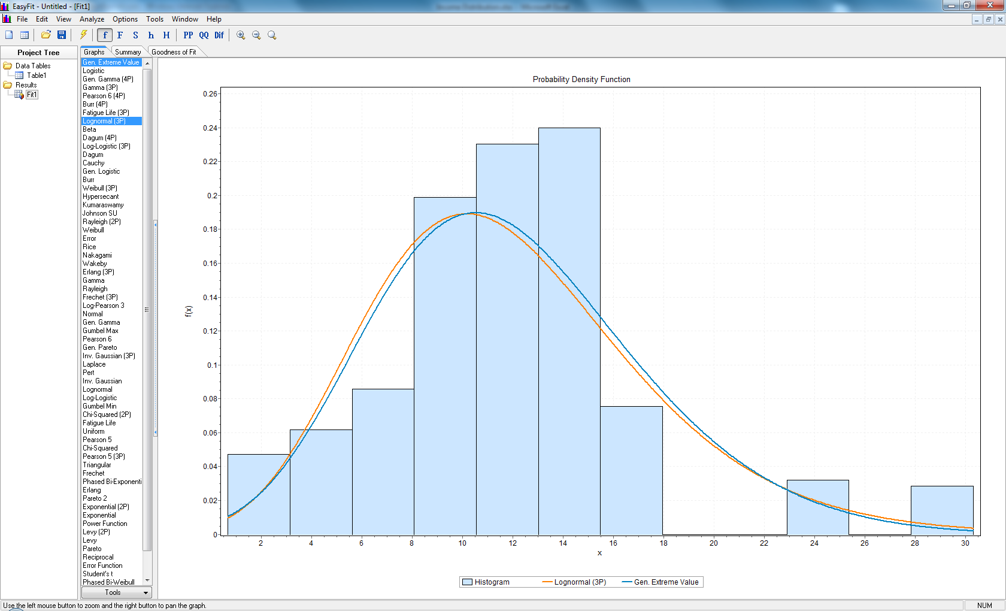
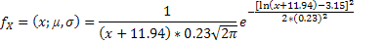
2.3 VOT Distribution
Assumption:
VOT : 50% of hourly rate (Concas and Kolpakov, 2009)
Best fit: Gen. Extreme Value (Orange)
Distribution will be used in DTALite: Lognormal (Blue).
Average VOT: 12 $/hour.
35

Slide 36
2.4 Multiple Traffic Simulation Models
BPR travel time functions
Point queue (relaxed storage constraints)
Spatial queue (similar to DYNASMART-P model)
Newell’s model (similar to Cell Transmission Model)
Shockwave propagation
36

Slide 37
2.4 Multiple Traffic Simulation Models
Newell’s simplified kinematic wave model
Outflow capacity
Inflow capacity
Storage capacity
Exit Queue
Entrance List
Inflow Capacity
Outflow Capacity
Storage Capacity
37

Slide 38
2.4 Multiple Traffic Simulation Models
Newell’s simplified kinematic wave model
Triangular flow-density relationship
Free flow speed, jam density, backward wave speed
38

Slide 39
2.4 Multiple Traffic Simulation Models
Queue propagation
Inflow capacity = outflow capacity
Inflow Capacity
Outflow Capacity
39

Slide 40
2.4 Multiple Traffic Simulation Models
Node transfer
Node Transfer
Node
Check Outflow Capacity
Check Inflow Capacity
Check Storage Capacity
40
Notes:
Going into more specifics, let’s take a closer look at the link pass and node pass. The capacity constraints are enforced at both ends of each link. At the beginning of the link, the entrance list keeps track of vehicles entering the link, enforcing the inflow capacity constraint. During the link pass, the vehicles are moved between the entrance list and the exit queue. The exit queue keeps track of vehicles waiting to leave the link, enforcing the outflow capacity constraint. Vehicles are then moved between the exit queue and the entrance list of the next link during the node.

Slide 41
2.4 Multiple Traffic Simulation Models
Merge Models
Distribute inflow capacity to upstream links
Lane & demand-based methods
80%
Node
Available Inflow Capacity
20%
41

Slide 42
2.4 Multiple Traffic Simulation Models
Diverge Models
Different conditions by lane
First-In-First-Out (FIFO) constraint
Relaxation to prevent extreme bottlenecks
Node
42

Slide 43
2.4 Multiple Traffic Simulation Models
Signalized Intersections
Effective green time, saturation flow rate, movement-based capacity
Relaxed inflow constraints
43

Slide 44
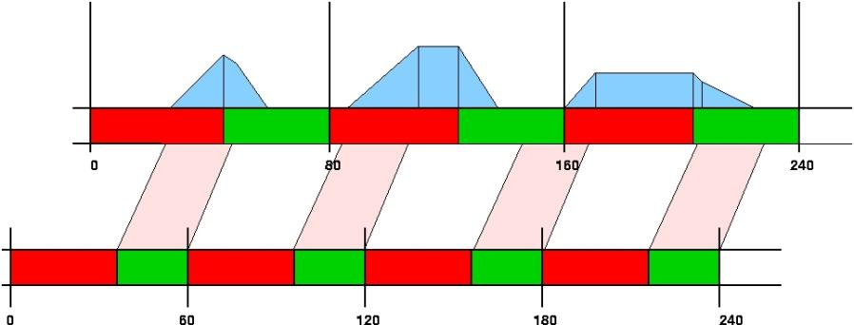
2.4 Multiple Traffic Simulation Models
Signal Timing & Hourly Capacity
Input: Average hourly capacity, cycle time, offset at node
Output: Effective green time per cycle(capacity/saturation flow rates)
44

Slide 45
Module 3 Visualization Features in NeXTA
3.1 Basic GUI features
3.2 View/Edit data files in NEXTA’s “project” menu
3.3 Integration with assignment model
3.4 Advanced visualization functions of NEXTA
3.5 MOE related display
3.6 Data exporting to Google Earth /GIS package

Slide 46
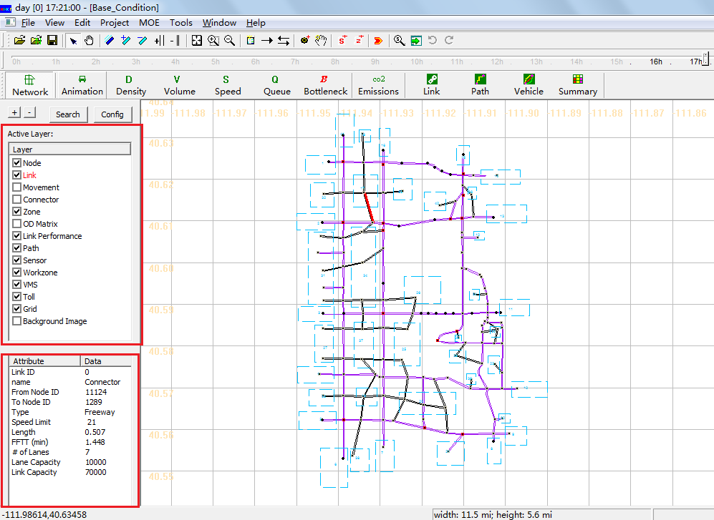
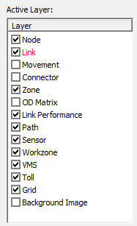
3.1 Basic GUI features
Turn on and off GIS layers; Move around, select node and links; Toolbars for editing networks
Open project folder (CSV file format)

Slide 47
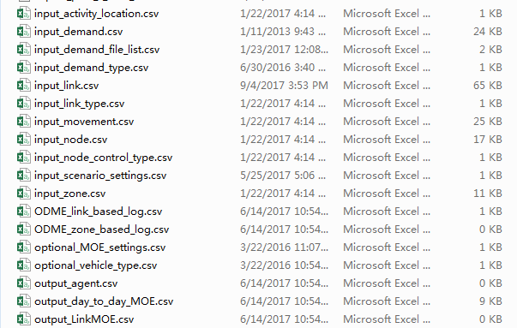
3.1 Basic GUI features
Turn on and off GIS layers; Move around, select node and links; Toolbars for editing networks
Open project folder (CSV file format)

Slide 48
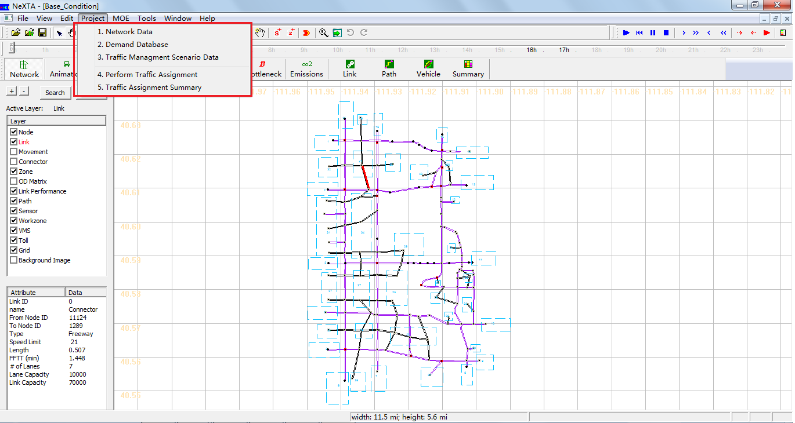
3.2 View/Edit data files in “project” menu
Node/link/zone/activity location
Demand meta database
Scenario files

Slide 49
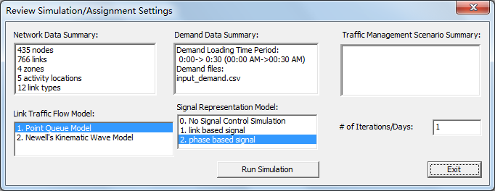
3.3 Integration with assignment model
Traffic flow model
Traffic Assignment method

Slide 50
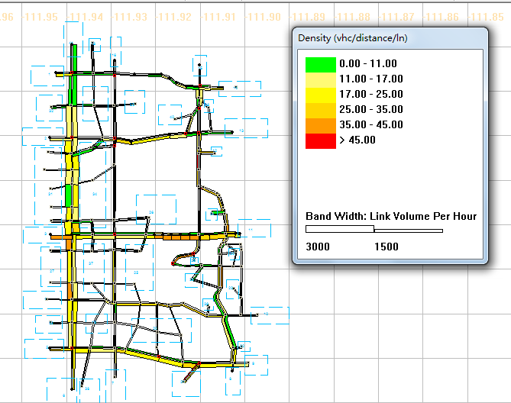
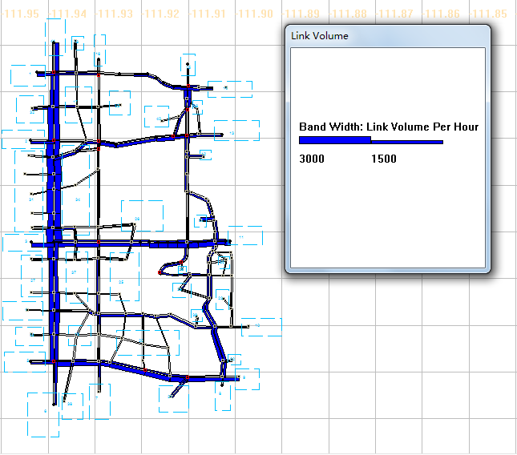
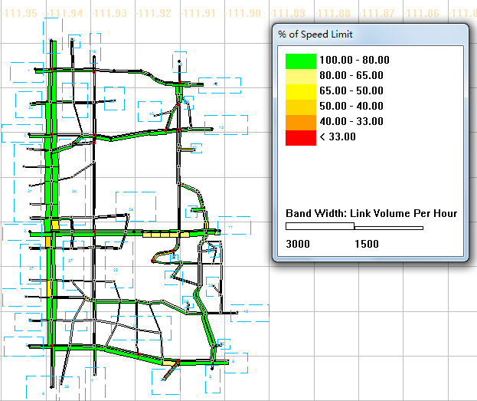
3.4 Advanced visualization functions of NeXTA
24-hour Time control/Clock bar
Volume (bandwidth), density, speed
Animation and queue: (turn off node layer and bandwidth)

Slide 51
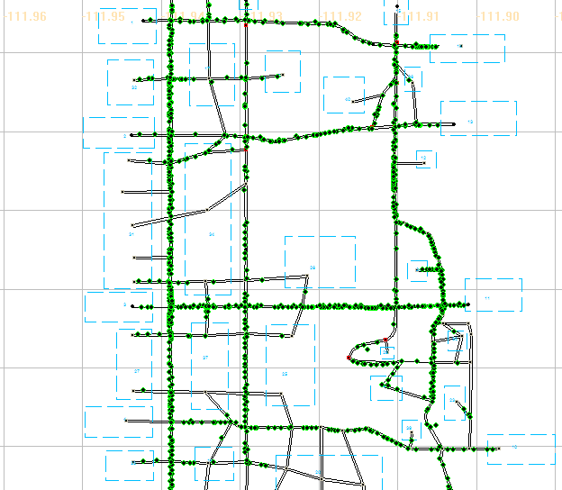
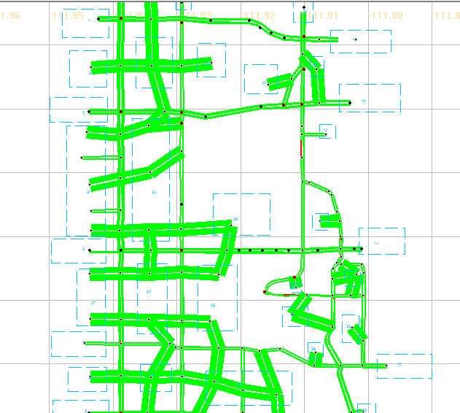
3.4 Advanced visualization functions of NeXTA
24-hour Time control/Clock bar
Volume (bandwidth), density, speed
Animation and queue: (turn off node layer and bandwidth)

Slide 52
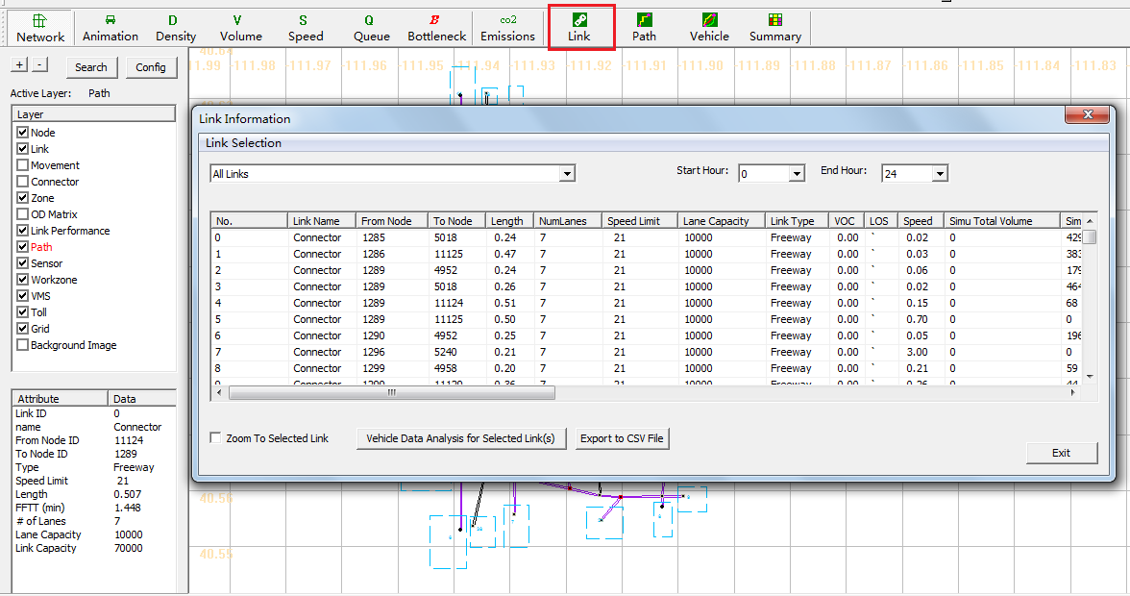
3.5 MOE related display
Link-related display
Path-related display
Vehicle and Summary Charts

Slide 53
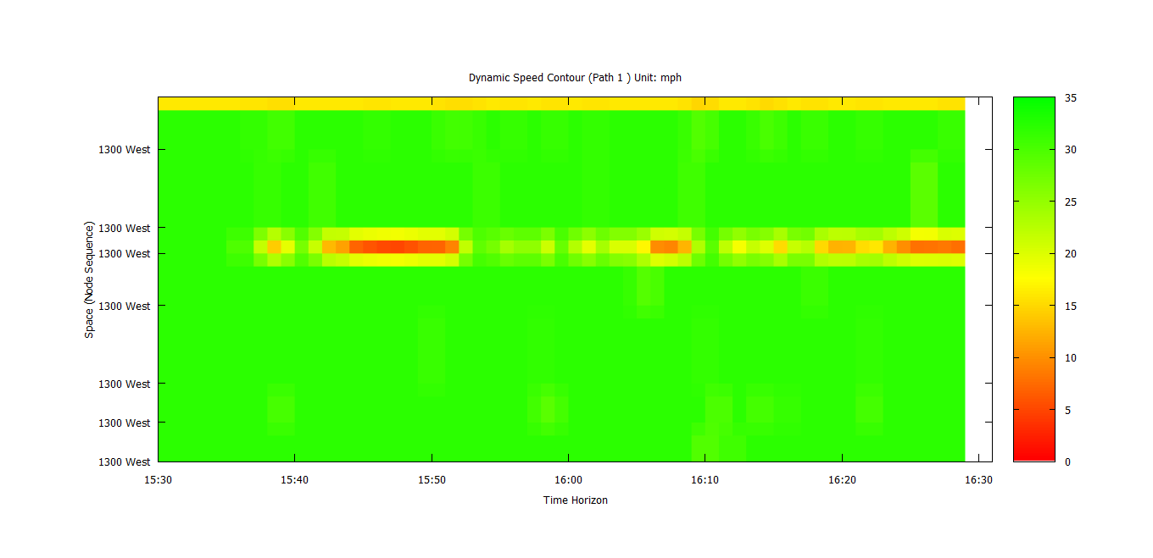
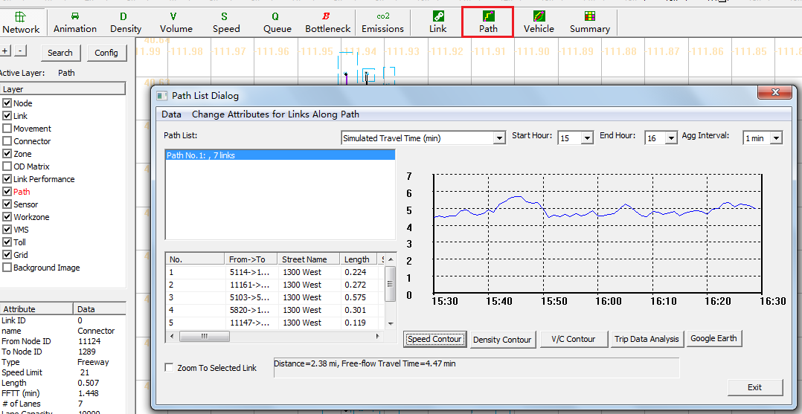
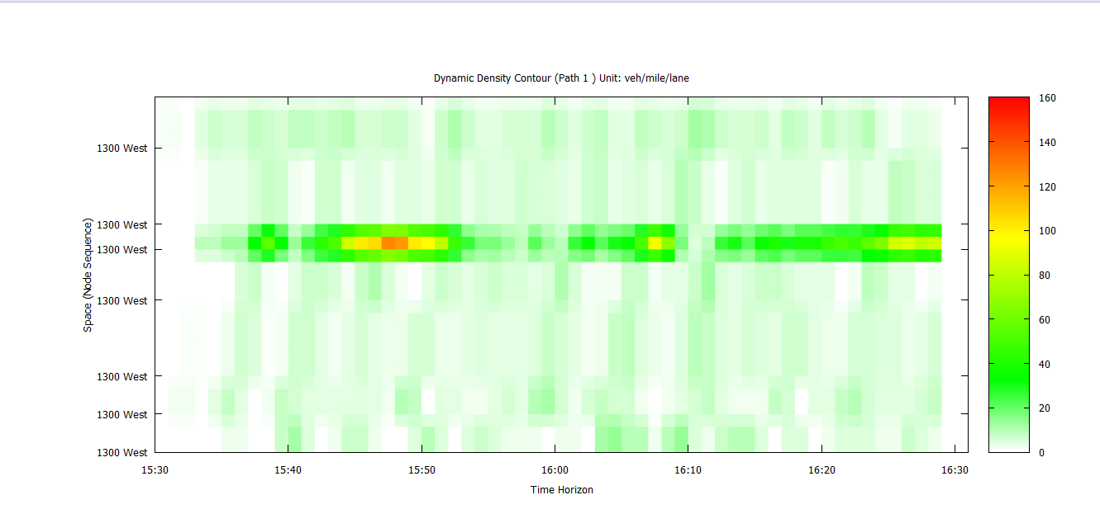
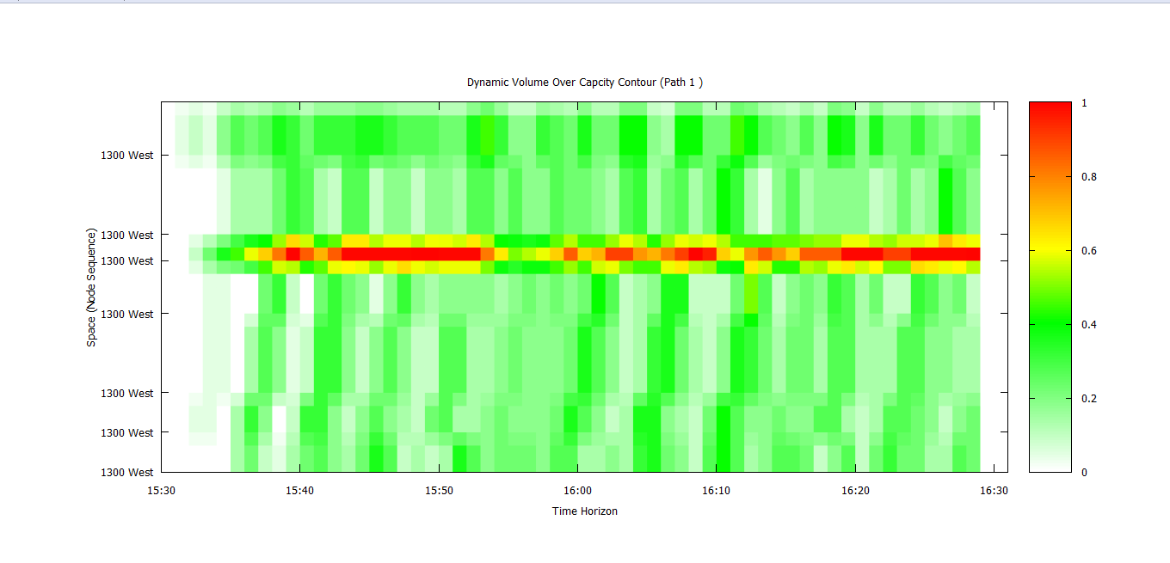
3.5 MOE related display
Link-related display
Path-related display
Vehicle and Summary Charts

Slide 54
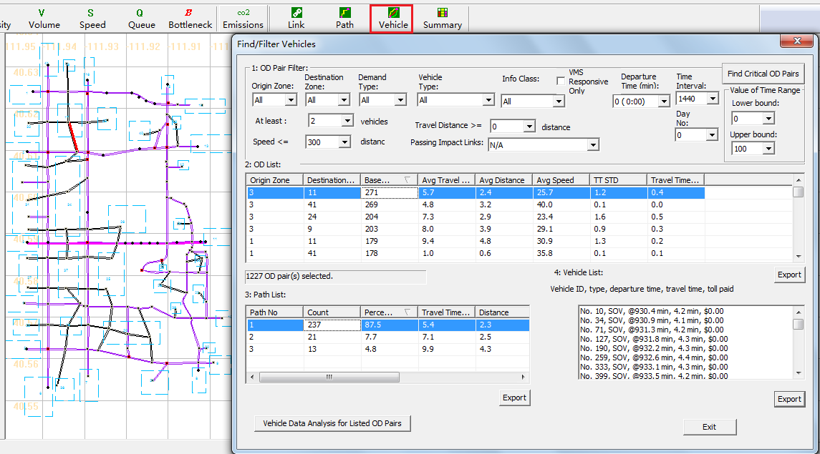
3.5 MOE related display
Link-related display
Path-related display
Vehicle and Summary Charts

Slide 55
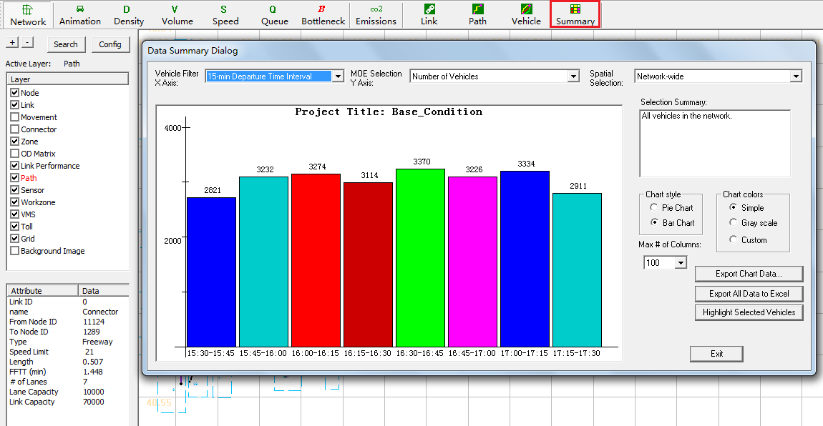
3.5 MOE-related display
Link-related display
Path-related display
Vehicle and Summary Charts

Slide 56
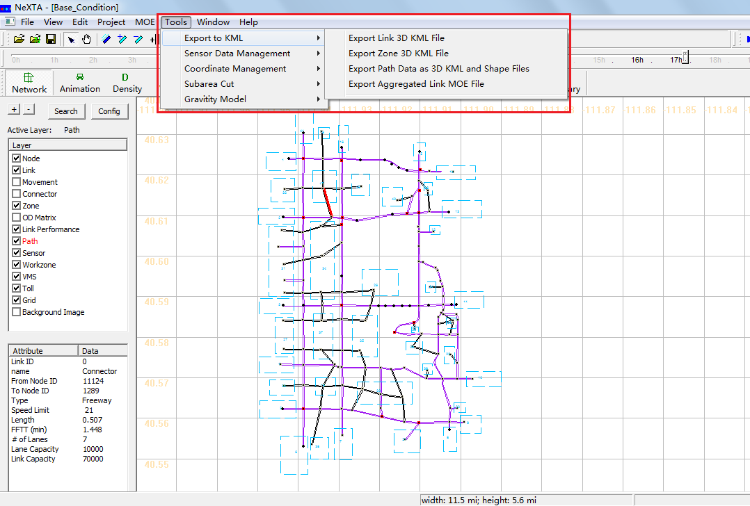
3.6 Export Data to Google Earth/GIS package
2D KML, 3D KML, GIS shape files
Google Earth visualization
Zone level display: adjust height/color

Slide 57
Module 4 Introduction to Workshop Exercises
4.1 Data Preparation for Building A Regional Traffic Network
4.2 Clackamas Network Modeling(Calibration)

Slide 58
4.1 Data Preparation for Building A Regional Traffic Network
Data Block | File Name
GIS Shape Files | 1a: node shape file
 | 1b: link shape file
 | 1c: zone shape file
GIS Importing Setting Files | 2: input_GIS_setting.csv
Advanced Definition Files | 3a: input_node_control_type.csv
 | 3b: input_link_type.csv
 | 3c: input_demand_type.csv
 | 3d: optional_vehicle_emission_rate.csv
Demand Files | 4.Demand files
Simulation Configuration Files | 5: input_demand_file_list.csv
 | 6. input_scenario_settings.csv
D: Scenario Files | 7a: sensor_count.csv
 | 7b: sensor_speed.csv
 | 8: Scenario_Work_Zone.csv
 | 9: Scenario_Dynamic_Message_Sign.csv
 | 10: Scenario_Link_Based_Toll.csv
58

Slide 59
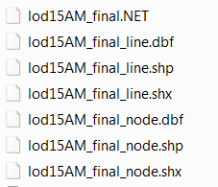
Step 1: Prepare Required Shape files
4.1 Data Preparation for Building A Regional Traffic Network
node shape file (1a)
link shape file (1b)
zone shape file (1c) -- optional
e.g. given shape files for the Atlanta network:
- lod15AM_final_node.shp:
provide node ID and coordinate values;
- lod15AM_final_line.shp:
provide from node id, to node id, length of links,
link type, number of lanes of link, ect.
59

Slide 60
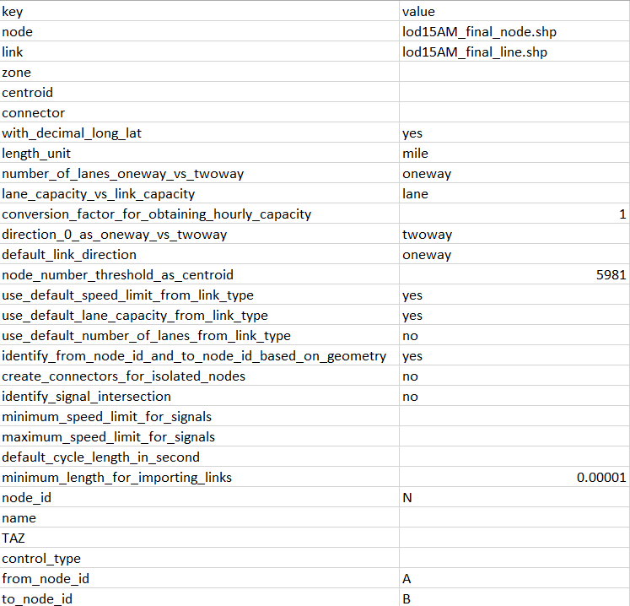
4.1 Data Preparation for Building A Regional Traffic Network
Step 2: Extract GIS information from shape files –importing configuration
The hub between shape files and NeXTA network data is import_GIS_settings.csv.(2)
How to do the settings for import_GIS_settings.csv can be found at the learning document in “DTALite-NEXTA-Software-Package”
[3] learning_document_GIS_importing.docx
60

Slide 61
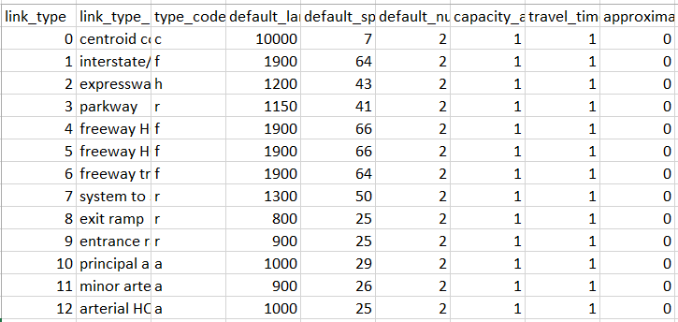
4.1 Data Preparation for Building A Regional Traffic Network
Step 3: Meta data files for building the network
input_link_type.csv (3b)
input_node_control_type.csv(3a) -- optional
61

Slide 62
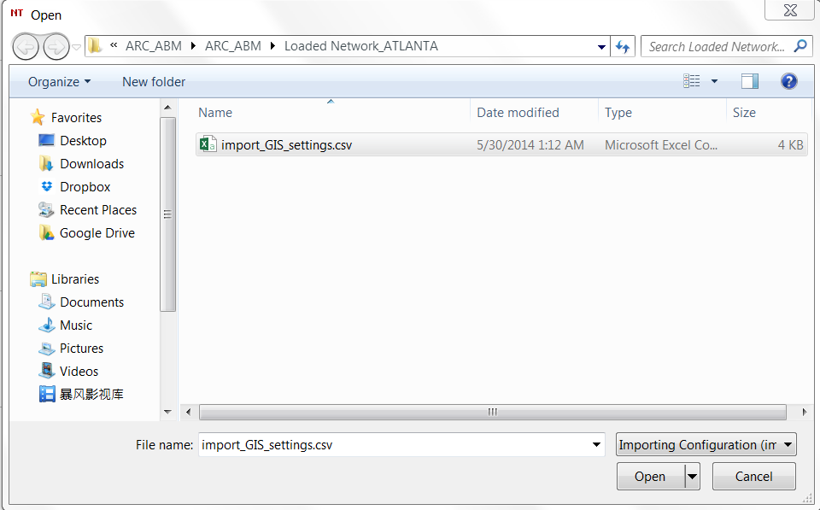
4.1 Data Preparation for Building A Regional Traffic Network
Step 4: Import GIS network to NeXTA
Open NEXTA_GIS_Import.exe that is the only one program to generate traffic network;
Click “File” ->“Import GIS Data Set”->“Next”. It will display the following dialogue.
62

Slide 63
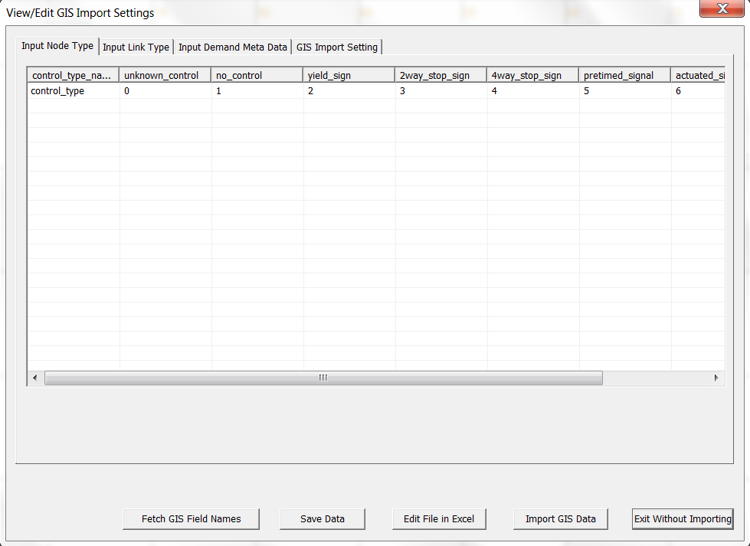
4.1 Data Preparation for Building A Regional Traffic Network
Step 4: Import GIS network to NeXTA
Choose the import_GIS_setting.csv file and open it. It will display the right interface: those four csv files can be checked here.
63

Slide 64
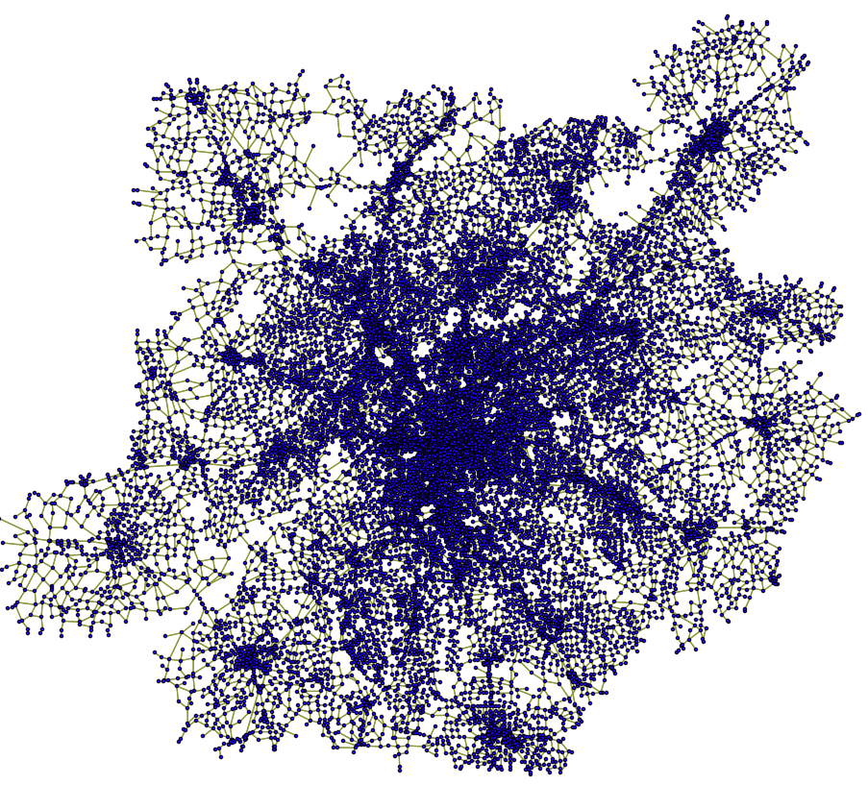
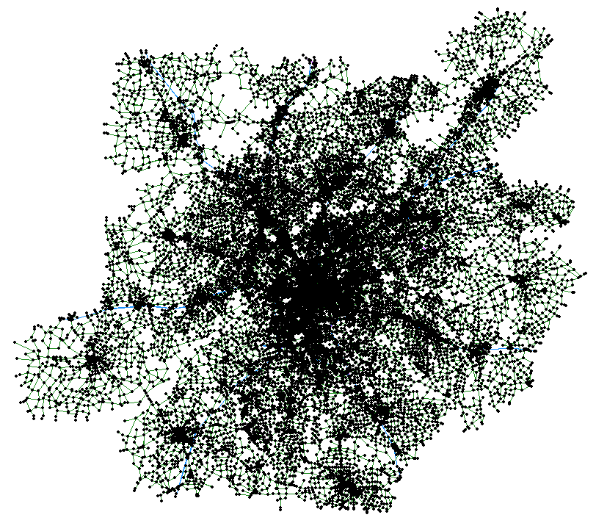
4.1 Data Preparation for Building A Regional Traffic Network
Step 4: Import GIS network to NeXTA
Click “Import GIS Data” button. And the network will be generated.
GIS Shape files
NeXTA
64

Slide 65
4.1 Data Preparation for Building A Regional Traffic Network
Step 5: Prepare Demand files
Demand file (4) is the source of dynamic traffic assignment. Generally, it is provided by users. And all types of demand should be defined in Input_demand_type(3c)
NeXTA can accommodate various demand formats:
column format from VISUM,
matrix format,
full matrix format,
Dynasmart format,
agent file,
and so on.
65

Slide 66
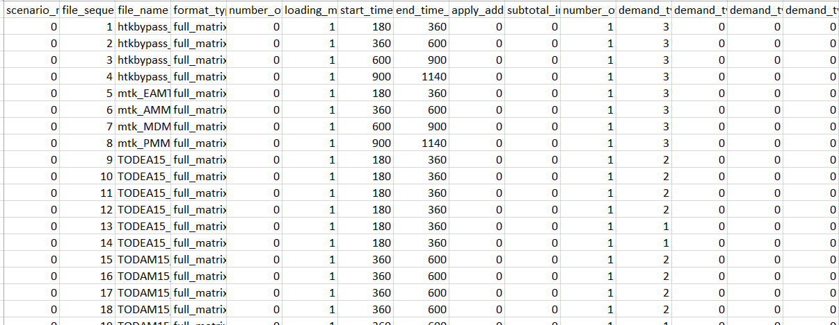
4.1 Data Preparation for Building A Regional Traffic Network
Step 5: Prepare Demand files
Input_demand_file_list.csv(5) is used to define the characteristics of demand data (4).
66

Slide 67
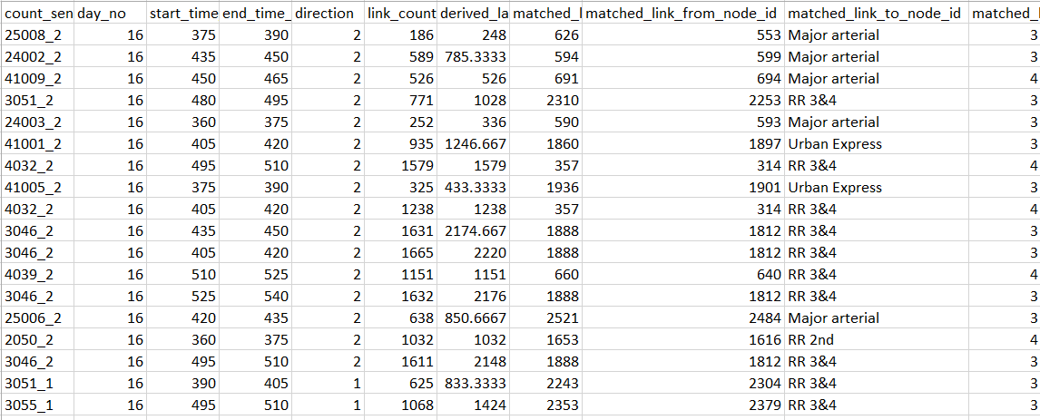
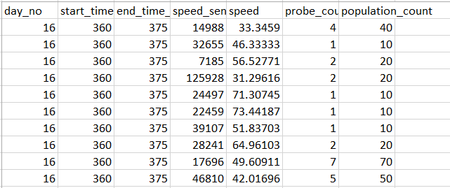
4.1 Data Preparation for Building A Regional Traffic Network
Step 6: Data required for OD Demand calibration
sensor_count.csv (7a)
link_count , matched_link_from_node_id, matched_link_to_node_id;
sensor_speed.csv(7b)
speed_sensor_id , speed, population_count;
Sensor_count.csv
sensor_speed.csv
67

Slide 68

4.1 Data Preparation for Building A Regional Traffic Network
Step 7: Work zone evaluation
The setting file for work zone simulation is
Scenario_Work_Zone.csv (8)
Scenario_Work_Zone.csv
68

Slide 69

4.1 Data Preparation for Building A Regional Traffic Network
Step 8: VMS evaluation
Scenario_Dynamic_Message_Sign.csv(9) is used to define the location and characteristics of variable message signs in the simulation
Scenario_Message_Sign.csv
69

Slide 70

4.1 Data Preparation for Building A Regional Traffic Network
Step 9: Tolling evaluation
Scenario_Link_Based_Toll.csv (10)
Since the toll for different demand types is represented by money, the data Value of Time in input_demand_type.csv is important.
Scenario_Link_Based_Toll.csv
70

Slide 71

4.1 Data Preparation for Building A Regional Traffic Network
Step 10: Emission evaluation(9a)
optional_vehicle_emission_rate.csv (3d)
optional_vehicle_emission_rate.csv
71

Slide 72

4.1 Data Preparation for Building A Regional Traffic Network
Step 11: Run Simulation
Input_scenario_setting.csv (6)
Input_scenario_setting.csv
72

Slide 73

4.2 Clackamas Network Modeling(Calibration)
Converting from Macroscopioc Model to Mesoscopic Model
Directly import important network attributes: Capacity, speed, number of lanes, etc.
First Simulation Run:
Wide-scale Gridlock (Red)
Notes:
In our first example, let’s take a look at a simple macroscopic model that was converted for use with our mesoscopic model. We directly imported the network attributes, including capacity, speed, and the number of lanes. This creates an underlying assumption that the macroscopic capacities are compatible with the capacities in our mesoscopic model. In effect, we are using the macroscopic capacities for the capacity constraints in the DTA model. In our first simulation run, with very few adjustments, we found wide-scale gridlock, shown in red here. As you can see, they were appropriate in some locations in this model, mostly on freeways, but not so much in others. In this case, ramp capacities were causing significant queuing, and were creating more queuing in the arterial street network.

Slide 74

4.2 Clackamas Network Modeling(Calibration)
Second Attempt
Increased ramp outflow capacity
- Still experiencing significant queuing

Slide 75
4.2 Clackamas Network Modeling(Calibration)
Inflow/Storage Capacity?

Slide 76

4.2 Clackamas Network Modeling(Calibration)
Geometry Details
Two-lane ramp, coded with one lane
- Reasonable outflow capacity
- Potential issues
Underestimated inflow capacity
- Underestimated storage capacity
Notes:
In this example, we find an interesting two-lane on-ramp entering the freeway. It begins as a two-lane facility, and enters the freeway as a one-lane facility. The ramp link was coded with one lane, which accurately represents the outflow capacity at the end of the link. However, since we’re missing a lane over a portion of the link, we’ve underestimated both the inflow capacity and storage capacity.

Slide 77
4.2 Clackamas Network Modeling(Calibration)
Traffic Flow Model Sensitivity

Slide 78

4.2 Clackamas Network Modeling(Calibration)
Third Attempt
Reset outflow capacity, adjusted inflow & storage capacity

Slide 79

4.2 Clackamas Network Modeling(Calibration)
Combined Modifications
Combination of adjusting outflow and storage capacity appears more reasonable

Slide 80
4.2 Clackamas Network Modeling(Calibration)
Recommended Diagnostic Procedures
Macroscopic capacity may not be appropriate for mesoscopic capacity constraints
Understand the traffic flow model
Understand limitations, special cases
Adjust capacity before OD demand, path flow
Start with fewer capacity constraints to remove possible unrealistic bottlenecks
Point queue → Spatial queue → Shock wave → Speed-density relationships

Slide 81
Outline
Module 5: Traffic Flow Theory
Module 6: OD Matrix Estimation
Module 7: Signalized Intersections Modeling
Module 8: VRP code
81
Notes:
As I just mentioned, the webinar is divided into four parts, referring to four separate videos which make up this recorded session. This is the first session, where we’ll introduce you to DTALite and NeXTA, and provide an overview of our project development so far.

Slide 82

Synchronized display in NeXTA
82

Slide 83
Vehicle Analysis Dialog

Slide 84
Module 3: Modeling Approach
84

Slide 85

Module 5 Traffic Flow Theory
5.1 Traffic Congestion Propagation: Understanding Theoretical Basics of Dynamic Traffic Network Assignment and Simulation
Contributing Author: Jiangtao Liu
https://scholar.google.com/citations?user=VLP4r4MAAAAJ&hl=en
5.2 Understand Network Equilibrium Model: Braess’ Paradox
Contributing Author: Tie Shi

Slide 86


Learning Objectives
5.1 Traffic Congestion Propagation
(1) Understand major input and
output data for a dynamic network
loading program;
(2) Identify bottlenecks and model congestion propagation;
(3) Calculate traffic states through different computational approaches.
Data Set
https://github.com/xzhou99/learning-transportation/tree/master/Lessons/Lesson%202/Data%20Set
86

Slide 87

Sample Case: 3-corridor Network
5.1 Traffic Congestion Propagation
87

Slide 88


Slide 89


Slide 90


Slide 91


Slide 92


Slide 93


Slide 94


5.1 Traffic Congestion Propagation
Case 1: demand = supply (multiplier = 1.0)
Graphical Method
U: interface between two different traffic states.
State O: there is no traffic flow
State A: the demand traffic enter the link 8->9
State C: the steady traffic state of link 9->10
The flow-density relationship for different states of links
94

Slide 95


Slide 96
Step 1: Check the value of traffic demand
5.1 Traffic Congestion Propagation
Case 1: demand = supply (multiplier = 1.0)
When Demand multiplier is 1.0, the hourly OD demand is 0.5*7200*1 = 3600 vehicles.
The limit capacity of the path 1 is 3600, so now the demand is equal to the path capacity.
The traffic demand from origin zone 1 to destination zone 2 is 7200 vehicles in two hours. You can check value of traffic demand from “input_demand.csv” in the project folder.
96

Slide 97

5.1 Traffic Congestion Propagation
Case 1: demand = supply (multiplier = 1.0)
Step 2: Setup simulation settings
Please use the following simulation settings shown in the flowing figure, and run simulation
Link Traffic Flow Model: “Newell’s Kinematic Wave Model”
# of Iterations/Days: 1
97

Slide 98
5.1 Traffic Congestion Propagation
Case 1: demand = supply (multiplier = 1.0)
Step 3: View the result of simulation and analyze traffic states
View the simulation result: “Total Volume over Capacity Ratio” in the file output_summary.csv
from_node_id | to_node_id | type_code | link_type | link_length | start_time_in_min | end_time_in_min | total_link_volume | lane_capacity_in_vhc_per_hour | link_capacity_in_vhc_per_hour | volume_over_capacity_ratio
1 | 3 | f | Freeway | 1 | 420 | 540 | 7200 | 1900 | 5700 | 0.6316
3 | 4 | f | Freeway | 1 | 420 | 540 | 7200 | 1800 | 5400 | 0.6667
4 | 5 | f | Freeway | 1 | 420 | 540 | 7200 | 1800 | 5400 | 0.6667
5 | 6 | f | Freeway | 1 | 420 | 540 | 7200 | 1800 | 5400 | 0.6667
6 | 7 | f | Freeway | 1 | 420 | 540 | 7200 | 1800 | 5400 | 0.6667
7 | 8 | f | Freeway | 1 | 420 | 540 | 7200 | 1800 | 5400 | 0.6667
8 | 9 | f | Freeway | 1 | 420 | 540 | 7200 | 1800 | 5400 | 0.6667
10 | 11 | f | Freeway | 1 | 420 | 540 | 7200 | 1800 | 3600 | 1
11 | 12 | f | Freeway | 1 | 420 | 540 | 7200 | 1800 | 5400 | 0.6667
9 | 10 | f | Freeway | 1 | 420 | 540 | 7200 | 1800 | 3600 | 1
12 | 2 | f | Freeway | 1 | 420 | 540 | 7200 | 1800 | 7200 | 0.5
98

Slide 99

5.1 Traffic Congestion Propagation
Case 1: demand = supply (multiplier = 1.0)
Step 3: View the traffic states of one path
Choose a path in the network
Click on the “Density Contour”, “Speed Contour”, and “V/C Contour” to analyze the details of this traffic assignment.
99

Slide 100

5.1 Traffic Congestion Propagation
Case 1: demand = supply (multiplier = 1.0)
Step 3: View the traffic states of one path
Similarly, other analyses can also be displayed easily.
link 9->10 and link 10->11 has a high density, which is consistent with the above “Total Volume over Capacity Ratio”.
100

Slide 101

5.1 Traffic Congestion Propagation
Case 1: demand = supply (multiplier = 1.0)
Step 4: View link MOE of bottleneck links
Simulated lane volume of link 8->9
101

Slide 102

5.1 Traffic Congestion Propagation
Case 1: demand = supply (multiplier = 1.0)
Step 4: View link MOE of bottleneck links
Simulated speed of link 8->9
102

Slide 103

5.1 Traffic Congestion Propagation
Case 1: demand = supply (multiplier = 1.0)
Step 4: View link MOE of bottleneck links
Simulated density of link 8->9
103

Slide 104

5.1 Traffic Congestion Propagation
Case 1: demand = supply (multiplier = 1.0)
Graphical Method
Vehicles’ trajectory in time-space diagram
Speed
The speed of link 8->9 and link 9->10 is the free flow speed, 60 mph, because the demand is equal to the capacity for the two links.
104

Slide 105
5.1 Traffic Congestion Propagation
Case 1: demand = supply (multiplier = 1.0)
Graphical Method
Vehicles’ trajectory in time-space diagram
Density
Link 8->9 is always at the state A and link 9->10 is at the state C, so its density is 60 vpmpl(link) for the both links.
Meanwhile, about the density of each lane, link 8->9 is 20 vpmpl(lane) and link 9->10 is 30 vpmpl(lane).
105

Slide 106
5.1 Traffic Congestion Propagation
Case 1: demand = supply (multiplier = 1.0)
Graphical Method
Vehicles’ trajectory in time-space diagram
Propagation time: N/A
106

Slide 107
5.1 Traffic Congestion Propagation
Case 2: demand > supply (multiplier = 1.2)
Step 1: Check the value of traffic demand
When the demand multiplier is 1.2, the hourly OD demand is 0.5*7200*1.2 (4320).
The limit capacity of the path 1 is 3600, so now the demand is slightly higher than the path capacity.
As a result, a traffic congestion is formed and further propagated to the upstream corridor.
107

Slide 108
5.1 Traffic Congestion Propagation
Case 2: demand > supply (multiplier = 1.2)
Step 2: Setup simulation settings
Go to input_demad_file_list.csv
Change the loading multiplier to 1.2 in the excel sheet
Run the simulation for 1 iteration.
108

Slide 109
5.1 Traffic Congestion Propagation
Case 2: demand > supply (multiplier = 1.2)
Step 3: View link MOE of path 1
traffic congestion starts from link 8->9, and then propagates back to upstream links
Then the traffic jam reaches the starting link 1->3 (without further space to accommodate the congestion), leading to continuously increasing density
109

Slide 110

5.1 Traffic Congestion Propagation
Case 2: demand > supply (multiplier = 1.2)
Step 4: View link MOE of bottleneck links
Simulated speed of link 8->9
110

Slide 111

5.1 Traffic Congestion Propagation
Case 2: demand > supply (multiplier = 1.2)
Step 4: View link MOE of bottleneck links
Simulated density of link 8->9
111

Slide 112
5.1 Traffic Congestion Propagation
Case 2: demand > supply (multiplier = 1.2)
Step 5: Describe traffic speed and density evolutions on links 7->8 and 8->9, Calculate the traffic congestion speed
The speed of link 8->9 changes from 60 mph to 15 mph in the first 20 min, and its density increases from 24 vpmpl to 80 vpmpl.
To calculate traffic congestion propagation speed, we need to measure the propagation time and link length (1 mile)
112

Slide 113

5.1 Traffic Congestion Propagation
Case 2: demand > supply (multiplier = 1.2)
Step 5: Describe traffic speed and density evolutions on links 7->8 and 8->9, Calculate the traffic congestion speed
Select two links simultaneously, link 8->9 and link 7->8.
Using key combination “ctrl +mouse click”, we can obtain the link MOE plot and then measure the queue propagation time.
113

Slide 114
5.1 Traffic Congestion Propagation
Case 2: demand > supply (multiplier = 1.2)
Step 5: Describe traffic speed and density evolutions on links 7->8 and 8->9, Calculate the traffic congestion speed
One can also precisely measure the exact propagation time duration using exported link MOE csv file.
When the density (link 8->9) becomes 80, the corresponding time is 441min.
When the density (link 7->8) becomes 80, the corresponding time is 455 min.
Thus, the propagation time duration is 14 min.
114

Slide 115
5.1 Traffic Congestion Propagation
Case 2: demand > supply (multiplier = 1.2)
Graphical Method
U: interface between two different traffic states.
State O: there is no traffic flow
State A: the demand traffic enter the link 8->9
State B: the steady traffic state of link 8->9
State C: the steady traffic state of link 9->10
The flow-density relationship for different states of links
115

Slide 116

5.1 Traffic Congestion Propagation
Case 2: demand > supply (multiplier = 1.2)
Graphical Method
Vehicles’ trajectory in time-space diagram
Speed
for link 8->9, at state A, its speed is 60 mph; at state B, due to the limitation of capacity, its speed is 15 mph.
For link 9->10, the vehicles will drive at a speed based on the capacity, state C, whose speed is 60 mph;
116

Slide 117
5.1 Traffic Congestion Propagation
Case 2: demand > supply (multiplier = 1.2)
Graphical Method
Vehicles’ trajectory in time-space diagram
Density
for link 8->9, at the state A, its density is 72 vpmpl(link). After the propagation time, it is at the state B, whose density is 240 vpmpl(link).
Meanwhile, the link 9->10 is always at the state C, whose density is 60 vpmpl(link).
117

Slide 118
5.1 Traffic Congestion Propagation
Case 2: demand > supply (multiplier = 1.2)
Graphical Method
Vehicles’ trajectory in time-space diagram
Propagation time: 14 min.
118

Slide 119
5.1 Traffic Congestion Propagation
Case 3: demand > supply (multiplier = 1.3)
Step 1: Check the value of traffic demand
In this case, the demand OD is still 7200 from 7am to 9am,
the multiplier is 1.3. so now the demand is much higher than the path capacity.
The analysis process is the same as case 2 (0.5*7200*1.3 = 4680 vehicles).
119

Slide 120
5.1 Traffic Congestion Propagation
Case 3: demand > supply (multiplier = 1.3)
Step 2: Setup simulation settings
Go to input_demad_file_list.csv
Change the loading multiplier to 1.3 in the excel sheet
Run the simulation for 1 iteration.
120

Slide 121

5.1 Traffic Congestion Propagation
Case 3: demand > supply (multiplier = 1.3)
Step 3: View link MOE of bottleneck links
Simulated speed of link 8->9
121

Slide 122

5.1 Traffic Congestion Propagation
Case 3: demand > supply (multiplier = 1.3)
Step 3: View link MOE of bottleneck links
Simulated density of link 8->9
122

Slide 123

5.1 Traffic Congestion Propagation
Case 3: demand > supply (multiplier = 1.3)
Step 4: Describe traffic speed and density evolutions on links 7->8 and 8->9, Calculate the traffic congestion speed
The speed of link 8->9 changes from 60 mph to 15 mph, and its density of one lane increases from 26 vpmpl to 80 vpmpl.
A traffic congestion propagation time of 9 min can be observed in the following figure.
123

Slide 124
5.1 Traffic Congestion Propagation
Case 3: demand > supply (multiplier = 1.3)
Graphical Method
U: interface between two different traffic states.
State O: there is no traffic flow
State A: the demand traffic enter the link 8->9
State B: the steady traffic state of link 8->9
State C: the steady traffic state of link 9->10
The flow-density relationship for different states of links
124

Slide 125
5.1 Traffic Congestion Propagation
Case 3: demand > supply (multiplier = 1.3)
Graphical Method
Vehicles’ trajectory in time-space diagram
Speed
For link 8->9, at state A, its speed is 60 mph; at state B, due to the limitation of capacity, its speed is 15 mph.
For link 9->10, the vehicles will drive in a speed based on the capacity, state C, whose speed is 60 mph;
125

Slide 126
5.1 Traffic Congestion Propagation
Case 3: demand > supply (multiplier = 1.3)
Graphical Method
Vehicles’ trajectory in time-space diagram
Density
For link 8->9, at state A, its density is 78 vpmpl(link). After the propagation time, at state B, its density is 240 vpmpl.
Meanwhile, the link 9->10 is always at the state C, whose density is 60 vpmpl(link). In addition, the method of calculating the density of each lane is the same as case 1.
126

Slide 127
5.1 Traffic Congestion Propagation
Case 3: demand > supply (multiplier = 1.3)
Graphical Method
Vehicles’ trajectory in time-space diagram
Propagation time: 9 min.
127

Slide 128
5.2 Traffic States as a result of demand-supply interactions
Base case without toll settings

Slide 129

Input_demand_type
Scenario_Link_Based_Toll.csv

Slide 130

Learning Objectives
5.2 Equilibrium Model: Braess’ Paradox
Understand modeling principles of user equilibrium
Know how to setup BPR function parameters for special link types
Understand the impact of adding a link and analyze the performance at link, path and network levels
The impact of different levels of demand on Braess’ paradox
Understand the impact of road pricing on Braess paradox and how to resolve Braess’ Paradox
Source of Braess’ Paradox:
http://en.wikipedia.org/wiki/Braess%27s_paradox
130

Slide 131

Step 1: Locate a file called "NeXTA.exe " from the Braess Network Data Set and open the application.
5.2 Equilibrium Model: Braess’ Paradox
Task 1: Build a network for static traffic assignment, and configure BPR parameters
131

Slide 132

Step 2: in NeXTA, open the Braess_Network.tnp from the Braess Network Data Set.
5.2 Equilibrium Model: Braess’ Paradox
Task 1: Build a network for static traffic assignment, and configure BPR parameters
132

Slide 133
Step 2: in NeXTA, open the Braess_Network.tnp from the Braess Network Data Set.
5.2 Equilibrium Model: Braess’ Paradox
Task 1: Build a network for static traffic assignment, and configure BPR parameters
133

Slide 134

Step 2: in NeXTA, open the Braess_Network.tnp from the Braess Network Data Set.
5.2 Equilibrium Model: Braess’ Paradox
Task 1: Build a network for static traffic assignment, and configure BPR parameters
The following network file will be loaded into NeXTA, which has 4 nodes and 5 links.
134

Slide 135
Step 2: in NeXTA, open the Braess_Network.tnp from the Braess Network Data Set.
5.2 Equilibrium Model: Braess’ Paradox
Task 1: Build a network for static traffic assignment, and configure BPR parameters
For notational convenience, the following discussion denote link1->3; 4->2; 1->4; 3->2; 3->4 as a, b, c, d, e, respectively.
135

Slide 136
Step 1: run simulation and view this data table by right-clicking and selecting 'View Link Data Table’ in link layer
5.2 Equilibrium Model: Braess’ Paradox
Task 2: Run simulation for the Braess network to carry out traffic assignment
 | Travel time function | Link Length | Lane capacity | # of lanes | BPR_alpha | BPR_beta
Links a, b | (v/100) | 0.01 | 1714 | 1 | 100 | 1
Links c, d | 45 min | 45 | 1900 | 3 | 0 | 1
136

Slide 137

TT = FFTT[1 + $α{(v/c)}^{β}$]
5.2 Equilibrium Model: Braess’ Paradox
Task 2: Run simulation for the Braess network to carry out traffic assignment
Step 1: run simulation and view this data table by right-clicking and selecting 'View Link Data Table’ in link layer
How do we specify the α and β for the links in Braess Network?
t=T/100 is re-expressed as t=v/100 --> FFTT = 0.01; α = 100; c = 100; β=1. so that the reconstructed function is 0.01*(1+100v/100) = 0.01+ v/100, which is close to v/100.
137

Slide 138

Step 2: Select a traffic flow model and Traffic Assignment Method.
5.2 Equilibrium Model: Braess’ Paradox
Task 2: Run simulation for the Braess network to carry out traffic assignment
Choose the option ‘Point Queue Model’ and 20 iterations.
Run simulation
138

Slide 139

Step 3: Review summary statistics
5.2 Equilibrium Model: Braess’ Paradox
Task 2: Run simulation for the Braess network to carry out traffic assignment
139

Slide 140

Step 4: Display the link volume.
5.2 Equilibrium Model: Braess’ Paradox
Task 2: Run simulation for the Braess network to carry out traffic assignment
First, click “config” (the button to the extreme left in NEXTA), which opens up a dialog box titled “Display Configuration”.
140

Slide 141

Step 4: Display the link volume.
5.2 Equilibrium Model: Braess’ Paradox
Task 2: Run simulation for the Braess network to carry out traffic assignment
The volume values on each link are shown in the map as shown below.
link | a | b | c | d
Total Link Volume (vhc) | 2006 | 1994 | 1994 | 2006
141

Slide 142

Step 5: Prepare statistics for the base case scenario.
5.2 Equilibrium Model: Braess’ Paradox
Task 2: Run simulation for the Braess network to carry out traffic assignment
Use the “vehicle” button to verify the path selection information
142

Slide 143
Step 5: Prepare statistics for the base case scenario.
5.2 Equilibrium Model: Braess’ Paradox
Task 2: Run simulation for the Braess network to carry out traffic assignment
Select “1” under the tab “Origin Zone” and “2” under “Destination Zone”,
143

Slide 144

Step 5: Prepare statistics for the base case scenario.
5.2 Equilibrium Model: Braess’ Paradox
Task 2: Run simulation for the Braess network to carry out traffic assignment
Click on the OD list populated, and then we can see the path list related to the demand, travel time at path 1.
144

Slide 145

Step 6: Use the “summary” button to verify the overall network performance.
5.2 Equilibrium Model: Braess’ Paradox
Task 2: Run simulation for the Braess network to carry out traffic assignment
Select the item “Avg Travel Time (min)” under the Y Axis drop-down list to show the average travel time in the network.
145

Slide 146

Step 1: Click “Path” on the GIS Layer Panel Menu on the left side of your screen
5.2 Equilibrium Model: Braess’ Paradox
Task 3: Using NEXTA to display the shortest path in Braess network.
Right click on Node 1 to choose the option “Direction from here”. Node 1 becomes a red highlighted box, ‘A’, indicating the start point of the shortest path
146

Slide 147

Step 1: Click “Path” on the GIS Layer Panel Menu on the left side of your screen
5.2 Equilibrium Model: Braess’ Paradox
Task 3: Using NEXTA to display the shortest path in Braess network.
Then right click on Node 2 to choose the option “Direction to here” and it becomes a red highlighted box, ‘B’.
147

Slide 148

Step 2: Right click on node 4, click on the “avoid this node” menu
5.2 Equilibrium Model: Braess’ Paradox
Task 3: Using NEXTA to display the shortest path in Braess network.
The shortest path from Node 1 to Node 2 is highlighted in the map as shown below.
148

Slide 149
Step 2: Right click on node 4, click on the “avoid this node” menu
5.2 Equilibrium Model: Braess’ Paradox
Task 3: Using NEXTA to display the shortest path in Braess network.
The path from node 1 to node 2 is now changed and no vehicle uses node 4 as it has been prevented.
 | Travel time | Flow
Path 1 | Link a(40.01) + Link d(45) = 85.01 min | 0
Path 2 | Link c(45) + Link b(40.01) = 85.01 min | 0
Path 3 | Link a(40.01)+ Link e(0.001)+ Link b(40.01) = 80.02 min | 4000
149

Slide 150
5.2 Equilibrium Model: Braess’ Paradox
Task 4: Compare System-wide Performance Differences between Two Networks.
The Braess paradox is a User Equilibrium (UE) system that is not necessarily System Optimal (SO).
Under the UE principle, the users are assumed to be greedy and rational to choose their own route with minimum cost, and users are familiar with the system.
 | Without adding link e | Adding link e
Total number of vehicles | 4000 | 4000
System-wide total travel time | 260040.7 | 320083.8
Average travel time for each vehicles | 65.01 | 80.02
Volume on link a | 2006 | 4000
Volume on link c | 1994 | 0
Path 1 travel time | 65.07 | 85.01
Path 1 volume | 2006 | 0
Path 2 travel time | 64.95 | 85.01
Path 2 Volume | 1994 | 0
Path 3 travel time | —— | 80.02
Path 3 Volume | 0 | 4000
150

Slide 151
5.2 Equilibrium Model: Braess’ Paradox
Task 4: Compare System-wide Performance Differences between Two Networks.
Remarks:
Comparing the average travel times before and after the addition of link e
it is interesting that the average travel time increases from 65.01-min to 80.02-min, due to the addition of link e.
After adding link e into the Braess Network, all the vehicles travel through link e, and the system-wide total travel time increases significantly.
151

Slide 152
5.2 Equilibrium Model: Braess’ Paradox
Task 4: Compare System-wide Performance Differences between Two Networks.
Remarks:
However, for one single vehicle, the driver does not have an incentive to switch his route, as the travel times for the other two paths (Path 1 and Path 2) are 85.01 minutes when all the other vehicles travel through link e (except for that one vehicle).
Therefore, there is a paradox on Braess network under reasonable assumptions, necessary and sufficient conditions in a general transportation network.
It should be noted that the length of link e must be short enough to ensure that the travel time on path 3 is less than the travel times on both path 1 and 2.
152

Slide 153

Step 1: Click “Toll” on the GIS Layer Panel, and then click to select link e.
5.2 Equilibrium Model: Braess’ Paradox
Task 5: Add a Link Toll and Run Static Simulation
Set link e as a Toll link by clicking “Add Link-based Toll” in the right click drop-down list.
153

Slide 154

Step 3: Run simulation on the new network and display the volumes on the map.
5.2 Equilibrium Model: Braess’ Paradox
Task 5: Add a Link Toll and Run Static Simulation
We can see some vehicles shifting from Path 3 to Path 1 and Path 2 because of introducing the toll on path 3.
 | a | b | c | d | e
Total Link Volume(vhc) | 3837 | 3845 | 163 | 155 | 3682
154

Slide 155

Step 1: Analysis of low demand on Braess Network
5.2 Equilibrium Model: Braess’ Paradox
Task 6: Sensitivity analysis using different demand levels
change the value of “Demand Loading Multiplier” at 0.1.
Then, the demand will change into 4000*0.1=400 (the original demand is 4000 ).
155

Slide 156

Step 1: Analysis of low demand on Braess Network
5.2 Equilibrium Model: Braess’ Paradox
Task 6: Sensitivity analysis using different demand levels
Run simulation using “BPR Function” as “Traffic Flow Model”
“Method of Successive Average” as “Traffic Assignment Method” on Braess network
display the volume value on the network.
 | a | b | c | d | e
Total Link Volume(vhc) | 400 | 400 | 0 | 0 | 400
156

Slide 157

Step 1: Analysis of low demand on Braess Network
5.2 Equilibrium Model: Braess’ Paradox
Task 6: Sensitivity analysis using different demand levels
Keep the “Demand Loading Multiplier” at 0.1.
Use BPR Function to run simulation and display the volume values on each link.
 | a | b | c | d | e
Total Link Volume(vhc) | 188 | 212 | 212 | 188 | 400
157

Slide 158
Step 1: Analysis of low demand on Braess Network
5.2 Equilibrium Model: Braess’ Paradox
Task 6: Sensitivity analysis using different demand levels
Compare and analysis the system performance between two networks under low demand.
 | Without adding link e | Adding link e
System-wide travel time | 18806.88 | 3208.37
Volume on link a | 188 | 400
Volume on link c | 212 | 0
Path 1 travel time | 46.89 | 49.01
Path 1 volume | 188 | 0
Path 2 travel time | 47.13 | 49.01
Path 2 volume | 212 | 0
Path 3 travel time | —— | 8.02
Path 3 volume | 0 | 400
158

Slide 159
Step 1: Analysis of low demand on Braess Network
5.2 Equilibrium Model: Braess’ Paradox
Task 6: Sensitivity analysis using different demand levels
From the statistics above, the system performance of the Braess network with link e is much better than the other’s.
The travel time for a single vehicle or whole system decrease because of link e. Thus, no paradox occurs.
159

Slide 160

Step 2: Analysis of high demand on Braess Network
5.2 Equilibrium Model: Braess’ Paradox
Task 6: Sensitivity analysis using different demand levels
change the value of “Demand Loading Multiplier” at 2.5.
Then, the demand will change into 4000*2.5=10000 (the original demand is 4000 ).
160

Slide 161

Step 2: Analysis of high demand on Braess Network
5.2 Equilibrium Model: Braess’ Paradox
Task 6: Sensitivity analysis using different demand levels
Choose “BPR Function” in “Traffic Flow Model” list
“Method of Successive Average” in “Traffic Assignment Method” list on Braess network
then click OK to start simulation. Display the volume values on the map.
 | a | b | c | d | e
Total Link Volume(vhc) | 5463 | 5020 | 4537 | 4980 | 483
161

Slide 162

Step 2: Analysis of high demand on Braess Network
5.2 Equilibrium Model: Braess’ Paradox
Task 6: Sensitivity analysis using different demand levels
Keep “Demand Loading Multiplier” at 2.5
Run the simulation using BPR Function to obtain the volume values on each link.
 | a | b | c | d
Total Link Volume(vhc) | 4827 | 5173 | 5173 | 4827
162

Slide 163
Step 2: Analysis of high demand on Braess Network
5.2 Equilibrium Model: Braess’ Paradox
Task 6: Sensitivity analysis using different demand levels
Compare and analysis the system performance between two networks under high demand.
 | Without adding link e | Adding link e
System-wide travel time | 950698.6 | 978817.97
Volume on link a | 4827 | 5463
Volume on link c | 5173 | 4537
Path 1 travel time | 93.28 | 99.64
Path 1 volume | 4827 | 4980
Path 2 travel time | 96.74 | 95.21
Path 2 volume | 5173 | 4537
Path 3 travel time | —— | 104.85
Path 3 volume | 0 | 483
163

Slide 164
Step 2: Analysis of high demand on Braess Network
5.2 Equilibrium Model: Braess’ Paradox
Task 6: Sensitivity analysis using different demand levels
From the statistics above, not all vehicles take the path 3 because of link capacity limitation.
And the travel time on path 3 is a little longer than other two paths’.
Neither does paradox occur under high demand in Braess network.
164

Slide 165
Module 6 Origin Demand Matrix Estimation
6.0 Background information

Slide 166




Why is OD Demand Estimation Important?
Essential input for traffic assignment systems to support transportation network planning and operational decisions
OD
Demand
Traffic
Assignment
Performance
Measures
Network
Capacity,
Traffic Control
Notes:
Formally, OD Demand can be definited as
Essential input …
In a traffic assignment system, we load OD demand into a traffic network with traffic control and information supply, provide a wide range of service measures in terms of as path flow, link flow and travel time
The Traffic assignment problem has been well studied in terms of formulation, solution algorithms mathematical properties.
How to obtain reliable OD demand input become the first priority for many most network planning and operational decisions, especially in calibration and validation
Even sophisticated traffic assignment procedure, inputing unreliable OD can still lead to problematic results
Garbage in and garbage out
Quality of OD demand info is critical for network planning and operational decisions, because how to provide sufficient supply in terms of transportation services to meet demand in terms of OD flows

Slide 167





Why do We Need to Utilize Different Data Sources?
Advanced sensor technologies offer more reliable and less costly channels to provide real-time traffic flow measurements
Survey Data
Point Sensor
Point-to-point Sensor
Loop Detector
Automatic Vehicle Identification
Notes:
Information overload?
Traditional survey methods cannot provide up-to-date dynamic demand inputs
Model estimation based on social-economic and geographic data
Survey samples from household, destination and roadside interviews
Advanced surveillance technologies offer more reliable and less costly channels to provide real-time traffic flow measurements
Common used loop detectors
My focus is ow
Turning Real-Time Data into Historical Data to
Support Strategic Decisions
Long term demand pattern
Time-consuming
Household, destination and roadside interview surveys, typically used in the transportation planning analysis, provide valuable samples about the detailed travel activities of each tripmaker, such as the origin and destination, the mode used and the travel time.
Populating OD demand patterns from survey samples, however, is a very costly and time-consuming process. Besides, the above traditional survey methods cannot provide up-to-date dynamic demand inputs required by on-line ATMS and ATIS applications.
more reliable and less costly channels to
Dynamic OD demand estimation can be viewed as a inverse problem of DTA
Data are overloaded

Slide 168
How has OD Matrix Estimation been Done?
Upper level:
Constrained ordinary least-squares problem
Lower level:
Link flow proportion = Traffic assignment ( )
ODME Optimization Model
Flow Pattern
OD Demand
Link Proportions
Traffic Assignment
Notes:
Note: In dynamic context and especially in congested networks, link-flow proportions are not constant and are, themselves, a nonlinear function of the (unknown) OD demand values.

Slide 169
What is Link-Flow Proportion?
Path Flow Structure
Link Proportions (Assignment matrix)
Fraction of vehicular demand flow from OD pair( i, j) contributing to the flow on link l
OD pair 1->3 1->4 2->3 2->4
Link a 1 1 0 0
Link b 1 1 1 0.3
Link c 0 0 0 0.7
Notes:
OD Demand split for a network with all counts on entry exit links
Genea
The Link Proportion Matrix captures the effects of route
choice, travel time dispersion and departure
time
#“It is a complete description of the TEMPORAL-SPATIAL
characteristics of traffic on a Network”
Link flow proportions
mlj
od (assignment matrix) is
the fraction of OD flows dod[t]
observed on link l at
observation time j and
leaving their origins at [t] (i.e.
at or before time slice j)
od (assignment matrix) is
the fraction of OD flows dod[t]
observed on link l at
observation time j and
leaving their origins at [t] (i.

Slide 170
Two Common Questions…
Travel time IS NOT the only factor in travel route choice utility function.
A long list of additional route choice factors: Highway bias, distance consideration, # of signals, inherence preferences
Do we need to reach the “perfect” travel-time-based UE in ODME?
2. Can we combine/integrate traffic assignment and OD demand estimation? (Both aim to adjust flows in a network)

Slide 171
What is the Difficulty of Dynamic ODME under Congested Conditions?
Single value of flow volume observation could correspond to free-flow and congested states
No linear link proportions available for density and travel time measurements
Free
flow
Congested

Slide 172
Our Proposed Approaches
1. Path Flow Adjustment
Combine OD estimation/adjustment with traffic assignment
Final solution is a set of path flow patterns satisfying “tolled user equilibrium”
2. Approximate Gradient Method
Use spatial queue model to calculate link flow/density change due to incoming path flow change

Slide 173
Objective Function: Minimize
Deviation between measured and estimated traffic states
Deviation between aggregated path flows and target OD flows
Demand flow target demand path flow target demand
(3) Gap Function to Quantify User Equilibrium Conditions

Slide 174

Flow Chart of Algorithm
Path flow adjustment based on all gradients

Slide 175

Example 1
Congested two-link Corridor:
Total demand = 8000 veh/hour
Path | FFTT (min) | Capacity (veh/hr) | Assigned Flow (veh/hr) | Travel Time (min)
Path 1 | 20 | 3000 | 5400 | 56
Path 2 | 30 | 3000 | 2600 | 56

Slide 176
Path Flow Volume Convergence Pattern

Slide 177
Path Travel Time Convergence Pattern

Slide 178
Algorithm Performance under Different Input Conditions
Information Availability |  |  |  | Estimation Result
Volume observations on path 1 only | Volume observations on path 2 only | Error-free target demand,8000vhc/hr | Error-free travel time on path 1 | Flow on path 1 | Flow on path 2 | Total estimated demand | Equilibrium travel time (min)
X |  |  |  | 5051.7 | 2367.8 | 7419.5 | 53.7
 | X |  |  | 4967.7 | 2311.8 | 7279.4 | 53.1
X | X |  |  | 5011.8 | 2341.2 | 7353.0 | 53.4
X | X | X |  | 5387.9 | 2592.0 | 7979.9 | 55.9
X | X | X | X | 5401.1 | 2600.7 | 8001.8 | 56.0

Slide 179
Multi-objective Programming Perspective
Gap Function: Degree of deviation from the original user equilibrium solutions
Vary penalty on path cost to generate non-dominated solutions
Gap Function
Measurement deviation

Slide 180
Sensitivity-Analysis and Gradient Information
Approximate the derivatives through simulation for each OD pair and each time interval in every iteration (Tavana, 2001)
Gradient approximation methods
Simultaneous Perturbation Stochastic Approximation (SPSA) framework by Balakrishna et al. (2008); Cipriani et al. (2011)

Slide 181

How to Use Spatial Queue Model to Evaluate Partial Derivatives with respect to Path Flow Perturbation? Case 1: Free-flow Conditions
Link inflow and outflow increase by 1 at entering time and leaving time, respectively.

Slide 182

Case 2: Congested Condition
Inspired by study by Ghali and Smith (1995)

Slide 183

Case 3: Two Partially Congested Links
Here!
Not Here!
The perturbation flow on the second link starts at the end of queue duration of the first link; rather than the vehicle entering time on second link
Similar work by Shen, Nie and Zhang (2007) for path marginal cost analysis

Slide 184

Case 4: Queue Spillback
Individual extra delay depends on when the vehicle/perturbation flow joins in the queue.

Slide 185
Summary
Integrated path-based OD demand estimation formulation
Gradient-based path flow adjustment process
Derive theoretically sound partial derivatives of link flow, density and travel time with respect to path flow perturbations

Slide 186


Mathematical Details: Gradient Based Formulation
Adjust path flow on each path based on generalized gradient/Cost
Individual gradients with respect to path flow adjustment
Calculated based on the spatial queue model

Slide 187

The process of one simulation for scenario analysis using estimated OD demand
6.1 OD Matrix Estimation Scenario
For performing scenario analysis, such as work zone, incident, ramp metering, etc., the travel demand should be calibrated in advance.
In this section, the integration of the two parts above is realized in DTALite through just one simulation, the process of which can be illustrated in the following Figure
187

Slide 188

Step 1: Build a Basic Network and Prepare Necessary Input Files for Basic Scenario
6.1 OD Matrix Estimation Scenario
Input_link.csv file
Set count sensor ID to “origin node -> destination node”
Set speed sensor ID to “origin node -> destination node”
188

Slide 189

Step 1: Build a Basic Network and Prepare Necessary Input Files for Basic Scenario
6.1 OD Matrix Estimation Scenario
Input_scenario_setting.csv file
so at least 30 iterations are required for the path flow adjustment for ODME
Specify traffic assignment method to “3>ODME”
189

Slide 190

Step 1: Build a Basic Network and Prepare Necessary Input Files for Basic Scenario
6.1 OD Matrix Estimation Scenario
Input_scenario_setting.csv file
Specify start and end iteration of ODME (the iteration number indicate that ODME will begin at the 21th iteration and end at the 50th iteration)
190

Slide 191

Step 2: Prepare Specific Input File for Signal Scenario
6.1 OD Matrix Estimation Scenario
Sensor_count.csv file
Specify count sensor ID, origin node ID and destination node ID of observed links
Specify observation time period of observed links
191

Slide 192

Step 2: Prepare Specific Input File for Signal Scenario
6.1 OD Matrix Estimation Scenario
Sensor_speed.csv file
Specify count sensor ID, origin node ID and destination node ID of observed links
Specify observation speed of observed links
192

Slide 193

6.1 OD Matrix Estimation Scenario
Step 3: Run Simulation and Perform Analysis
checking output_summary.csv file, users can better understand the process of ODME in DTALite.
193

Slide 194
6.1 OD Matrix Estimation Scenario
Step 3: Run Simulation and Perform Analysis
For the first 20 iterations, a standard dynamic user equilibrium method, MAS, is used.
It is expected to see the UE gap (Avg User Equilibirum (UE) gap (min) and Relative UE gap (%)) dramatically decreases and finally reach a stable state,
194

Slide 195

6.1 OD Matrix Estimation Scenario
Step 3: Run Simulation and Perform Analysis
Comparison result between observed link count and simulated link count after ODME
195

Slide 196
Module 7 Signalized Intersections Modeling
7.1 Link Based Signal Representation Model
7.2 Phase Based Signal Representation Model
7.3 Importing data from Synchro to DTALite
7.4. QEM (Signal Quick Estimation Method) Application to Generate signal timing data

Slide 197


Step 1: Build a Basic Network and Prepare Necessary Input Files for Basic Scenario
7.1 Link Based Signal Representation Model
Input_node.csv
Set the control type of signal intersections to signalized type
(e.g., the control type of node 5 is set to “pretimed signal” in this case)
197

Slide 198


Step 1: Build a Basic Network and Prepare Necessary Input Files for Basic Scenario
7.1 Link Based Signal Representation Model
Input_link.csv
Specify the number of left-turn lanes (including separated left-turn lanes and shared left-turn lanes)
198

Slide 199

Step 1: Build a Basic Network and Prepare Necessary Input Files for Basic Scenario
7.1 Link Based Signal Representation Model
Input_scenario_setting.csv
Set traffic flow model to “2> Spatial Queue Model”
Set signal representation model to “1> link based signal
199

Slide 200

Step 2: Prepare Specific Input File for Signal Scenario
7.1 Link Based Signal Representation Model
Input_movement.csv
Specify left-turn type movements and through-type movements which are required
200

Slide 201

Step 2: Prepare Specific Input File for Signal Scenario
7.1 Link Based Signal Representation Model
Input_signal.csv
the number of phase plan
starting time(in seconds), ending time(in seconds), cycle length(in seconds) and offset (in seconds) of each signal plan
201

Slide 202
Step 2: Prepare Specific Input File for Signal Scenario
7.1 Link Based Signal Representation Model
Input_signal.csv
saturation flow(per hour per lane), start time(in seconds) and end time(in seconds) for through-type movement and left-turned movement
Step 3: Run Simulation
202

Slide 203
Step 1: Build a Basic Network and Prepare Necessary Input Files for Basic Scenario
7.2 Phase Based Signal Representation Model
Input_node.csv
Input_link.csv
Setup data in these two files the same as “7.1 Link Based Signal Representation Model”
203

Slide 204

Step 2: Parameter settings in key simulation configuration files
7.2 Phase Based Signal Representation Model
Input_movement.csv
Movement id
turn direction
204

Slide 205
Step 2: Parameter settings in key simulation configuration files
7.2 Phase Based Signal Representation Model
input_signal_timing_plan.csv
Intersection id
Timing plan number
Start time and end time of timing plan
Starting phase
Offset
[TOD] | int_id | timing_plan_no | from_time | to_time | starting_phase | off_set
 | 5 | 1 | 0 | 86400 | 1 | 11
205

Slide 206
Step 2: Parameter settings in key simulation configuration files
7.2 Phase Based Signal Representation Model
input_timing.csv
Intersection id
Timing plan number
Number of phase
green duration, movement string and movement direction string of phase
[Signal] | int_id | timing_plan_no | phase_id | next_phase | green_duration | movement_str | movement_dir_str
 | 5 | 1 | 1 | 2 | 120 | 1_3_T; 1_2_L; 3_1_T; 3_4_L | WBT; WBL; EBT; EBL;
 | 5 | 1 | 2 | 1 | 70 | 2_4_T; 2_3_L; 4_2_T; 4_1_L | SBT; SBL; NBT; NBL;
206

Slide 207
Step 3: generate the input_timing_status.csv file with timing_generator.exe (Contributed by Prof. Pengfei Taylor Li, Currently maintained by the University of Maryland Prof. Lei Zhang’s Group )
7.2 Phase Based Signal Representation Model
Required files include input_timing.csv file and input_signal_timing_plan.csv file
movement_str | start_time_in_sec | end_time_in_sec | signal_status | from_node_id | to_node_id | turn_type
1_3_T | 0 | 119 | 1 | 1 | 5 | T
1_2_L | 0 | 119 | 1 | 1 | 5 | L
3_1_T | 0 | 119 | 1 | 3 | 5 | T
3_4_L | 0 | 119 | 1 | 3 | 5 | L
2_4_T | 120 | 189 | 1 | 2 | 5 | T
2_3_L | 120 | 189 | 1 | 2 | 5 | L
4_2_T | 120 | 189 | 1 | 4 | 5 | T
4_1_L | 120 | 189 | 1 | 4 | 5 | L
… | … | … | … | … | … | …
207

Slide 208

7.2 Phase Based Signal Representation Model
Step 3: NEXTA GUI instruction
Load the example project
Choose the Movement layer -> right click the intersection node -> View Movement Properties for Selected Node.
208

Slide 209

7.2 Phase Based Signal Representation Model
Step 3: NEXTA GUI instruction
If this section has the phase plan before, thus we could display them in NEXTA.
209

Slide 210
7.2 Phase Based Signal Representation Model
Step 4: Add/delete a phase in current phase
Add/delete a phase in current phase:
Check the box before Movement-Phasing Edit Mode
Double click the phase that you want to add/delete
210

Slide 211
7.2 Phase Based Signal Representation Model
Step 4: Add/delete a phase in current phase
then the corresponding movement_str will be changed in the table below
Click save timing file button, the input_timing file will be updated in the folder.
211

Slide 212

7.2 Phase Based Signal Representation Model
Step 5: Run Simulation and Perform Analysis
Input_scenario_setting.csv
Set traffic flow model to “2> Spatial Queue Model”
Set signal representation model to “2> phase based signal”
212

Slide 213


7.3 Importing data from synchro to DTALite
Step 1: Prepare the Synchro dataset
Export to LANES.cvs, LAYOUT.csv, PHASING.csv and TIMING.CSV (UTDF format).
213

Slide 214

7.3 Importing data from synchro to DTALite
Step 1: Prepare the Synchro dataset
Export to LANES.cvs, LAYOUT.csv, PHASING.csv and TIMING.CSV (UTDF format).
214

Slide 215

7.3 Importing data from synchro to DTALite
Step 2: Use nexta to import the synchro UTDF format.
Open NEXTA, click tools -> Import Synchro UTDF File:
215

Slide 216

7.3 Importing data from synchro to DTALite
Step 2: Use nexta to import the synchro UTDF format.
Open LAYOUT.csv File
216

Slide 217

7.3 Importing data from synchro to DTALite
Step 2: Use nexta to import the synchro UTDF format.
The synchro data will be imported to NEXTA.
217

Slide 218

7.3 Importing data from synchro to DTALite
Step 2: Use nexta to import the synchro UTDF format.
Save the project in the same folder
218

Slide 219

7.3 Importing data from synchro to DTALite
Step 2: Use nexta to import the synchro UTDF format.
The network and the signal data will be automatically saved into the folder.
219

Slide 220

7.3 Importing data from synchro to DTALite
Step 3: Mapping two networks
In this step, we have two networks (a) DTALite main network (b) the imported synchro network in DTALite format.
Rename the input_node.csv and input_link.csv to input_node_2.csv and input_link_2.csv and copy to our old DTALite network.
220

Slide 221

7.3 Importing data from synchro to DTALite
Step 3: Mapping two networks
Then, open the new project in NEXTA.
221

Slide 222

7.3 Importing data from synchro to DTALite
Step 3: Mapping two networks
Use lock/unlock reference network tool in reference line layer
222

Slide 223

7.3 Importing data from synchro to DTALite
Step 3: Mapping two networks
Move, zoom in and zoom out imported synchro network
223

Slide 224
7.3 Importing data from synchro to DTALite
Step 3: Mapping two networks
But now the node and Link ID of the two networks are different, we need to map them with our old DTALite Network.
Based on this, we could have the input_node_mapping.csv table generated by ourselves manually.
(e.g., Node_id_1 is the node id from the old DTALite network, node_id_2 is the mapping node from synchro exported network.)
node_id_1 | node_id_2
3346 | 251
3335 | 1208
3338 | 1505
… | …
224

Slide 225

7.3 Importing data from synchro to DTALite
Step 3: Mapping two networks
Get input_node_mapping.csv file in the last step
Copy the input_timing_2.csv from the Synchro to the new folder.
Then we could run the simulation of timing_movement_generater.exe and get the result of input_timing_mapping.csv:
225

Slide 226


7.3 Importing data from synchro to DTALite
Step 3: Mapping two networks
Verify the input phasing results and add required next phase number. in main DTA network
Make sure the imported phasing data are correctly display in NEXTA.
226

Slide 227
Generate default NEMA phasing for a signalized intersection
If a node is designated as a pretimed signal, and there is no input timing information provided, then NeXTA can generate the default NEMA phasing

Slide 228


Slide 229


Slide 230


Movement & Phase Numbering
Through Φ: even numbers (2,4,6,8)
Left turn Φ: odd numbers (1,3,5,7)
3-legged intersection LT can be even #
Φ 2 & 6 denote major street
Right turn Φ concurrent w/ through in most cases (no special RT Φ)
HCM 2010
Contributing Author:
Dr. Milan Zlatkovic

Slide 231

Ring-Barrier Phase Structure
Ring-barrier diagram – graphical representation of phases within sets of rings & barriers (NEMA standard, all traffic controllers)
Ring – phases that operate in sequence (cannot time simultaneously)
Barrier - separation of intersecting movements to prevent operating conflicting phases at same time
Split summations:
Φ 1+2+3+4 = C
Φ 5+6+7+8 = C
Exceptions?
Φ 1+2 = Φ 5+6
Φ 3+4 = Φ 7+8
Contributing Author:
Dr. Milan Zlatkovic

Slide 232

7.4 QEM (Signal Quick Estimation Method) Application
Contributing Author:
Dr. Milan Zlatkovic
Assistant Professor, University of Wyoming
http://www.uwyo.edu/civil/faculty_staff/faculty/milan-zlatkovic/index.html
Reference:
Integration of signal timing estimation model and dynamic traffic assignment in feedback loops: system design and case study
Milan Zlatkovic, Xuesong Zhou
Journal of Advanced Transportation 49 (6), 683-699, 2015

Slide 233


Slide 234
QEM Application: Overview
Challenges for Planners:
How to obtain signal data? Especially for future year with dramatically changed traffic pattern??
How do we obtain movement-specific capacity under prevailing traffic condition (e.g. different turning percentage) for a large number (100-500) of intersections?
The QEM_SIG Excel spreadsheet that accompanies NeXTA represents a computational engine for estimating signalized intersections operation
It relies on HCM 2010 and additional methodologies for computing parameters of signalized intersections
Can be used as a stand-alone application, or integrated with NeXTA
It is an open-source Excel application with friendly GUI for data input and viewing results

Slide 235
QEM Application: Sections
Sheet 1 – input/output sheet for communication with NeXTA
Input sheet – data input section; this is the only section where the user needs to input intersection data
Phase designation – assigns phases to intersection movements, determines left turn treatment and defines ring-barrier structure
Lane volumes – calculation of lane volumes (HCM 2010 Chapter 31)
Phase calculation – calculation of the cycle length, green time (splits) allocations, movement capacities, V/C ratios, and Levels of Service (LOS)
Phasing – calculates phasing data for correct export to Synchro
Summary sheet – output sheet with calculation results

Slide 236
QEM Application: Input Sheet 1/2
Street names – optional
Intersection lane configuration – required for stand-alone application; not needed for use with NeXTA
Turning volumes for each movement – required for stand-alone application; not needed for use with NeXTA
Approach through speeds – important if the speeds are greater than 45 mph; not needed for use with NeXTA
Presence of pedestrians – should be enabled for urban intersections
Manual selection of left turn treatment – optional for stand-alone application; not needed for use with NeXTA
Right Turn on Red (RTOR %) – 50-75% for exclusive right turn lanes, < 10% for shared

Slide 237
QEM Application: Input Sheet 2/2
Ideal saturation flow rate (Ideal So) – default value = 1900 vphpl; can be changed to reflect local conditions
Peak Hour Factor (PHF) – should be entered if known; otherwise, a default value of 0.9 can be used
Percentage of heavy vehicles (HGV %) – should be entered for local conditions; otherwise, a default value of 3% can be used
Lost Time (s) per phase – 4 seconds by default; can be changed to reflect local conditions
Area Type selection – “CBD” (Central business district) and “Other”; should be selected for the analyzed network
Minimum and maximum desired cycle lengths – by default, the cycle length is between 40 s (minimum) and 150 s (maximum)

Slide 238


Slide 239


Slide 240


Slide 241

QEM Application: Summary Sheet
Turning volumes (vph)
Phase designations
Number of lanes
Split durations (s)
Movement capacities (vph)
V/C ratios
Control delays (s)
Intersection LOS
Phase data table
Fig. 20 QEM Summary Sheet

Slide 242
Module 8: VRP Code
Source code link:
https://github.com/xzhou99/Agent-Plus/blob/master/cpp_source_code_v2_VRP/AgentPlus_VRP/AgentPlus/AgentPlus.cpp

Slide 243

Lagrangian Relaxation Model
Lagarangian Relaxation
Lagarangian Multipliers mean passengers’ profit

Slide 244



Input Data
Output Data
Initial profit of passengers
1. Lagrangian lower bound and primal upper bound
2. Passenger and vehicles’ assignments and time-space routes
Input_node
Input_link
Input_agent

Slide 245

Main functions
Generate_string_key():
Such as: n4_1[1]_3[2]_4[2], means node 4 with pickup of p1, delivery of p3 and delivery of p4
Including nodeID, passenger ID, and pickup or delivery state
Convenient for visiting in dynamic programming

Slide 246
Main Class
Class Name | Major functions | Major variables | Used modules
Node | CalculateCost() | PassengerID, VehicleID, LowerBound, UpperBound | Basic data
VRP_exchange_data //in one node | AddP2VAssignment (int p, int v) | LowerBound, UpperBound, V2PAssignmentVector | Branch & Bound
V2PAssignment //vehicles assigned for each p | AddCompettingVehID (int vehicle_id) | input_prohibited_vehicle_id_vector: not allowable vehicles output_competting_vehicle_id_vector: competing vehicles | Branch & Bound
CVSState //for vehicle scheduling states |  | LabelCost, PrimalLabelCost passenger_service_state | C_time_indexed_state_vector &DP
C_time_indexed_state_vector | update_state (CVSState new_element) | m_VSStateVector //vector of CVSState | DP

Slide 247
Main variables
For passengers | For vehicles
g_passenger_base_profit[passenger_id] →profit of passengers (LR multipliers) | g_time_dependent_state_vector[vehicle_id][t]. m_VSStateVector →state vector of a vehicle
competing_vehicle_size →competing vehicels | g_ending_state_vector[vehicle_id] →final state of a vehicle
input_prohibited_vehicle_id_vector →in Branch and Bound, vehicles which cannot serve passenger p

Slide 248
Branch & Bound

Slide 249
Branch & Bound

Slide 250

Branch & Bound
Assignment Problem Using Branch-And-Bound Method link:
https://math.stackexchange.com/questions/1466459/assignment-problem-using-branch-and-bound-method

Slide 251



Dynamic Programming
For vehicle v
For time t
for state w
for outbound of current w’s node i
calculate labelCost of (i,t,w):
if(the state does not exist)
create it
else if(the label cost of the temp state <
label cost of the existing state)
update the cost of the state
Loop
Calculate the cost of the node
Update the cost of the node

Slide 252



Lagrangian Relaxation for Lower Bound
Sub-gradient algorithm

Slide 253
Lagrangian Relaxation for Lower Bound
Upper bound generates the solution without the profit of passengers.

Slide 254

Example
Node | Lower Bound | Upper Bound
0 | 2 | 21
1 (v1-p1) | 10020 (cut)
2 (v2-p1) | 10020 (cut)
3 (p1 exclusive) | 10020 (cut)

Slide 255
Thank You!
Questions, Comments, and Suggestions are Welcome.
Please Contact:
Xuesong Zhou, Ph.D. Arizona State University
Tempe, AZ 85287
Email: xzhou74@asu.edu

